Slide 1
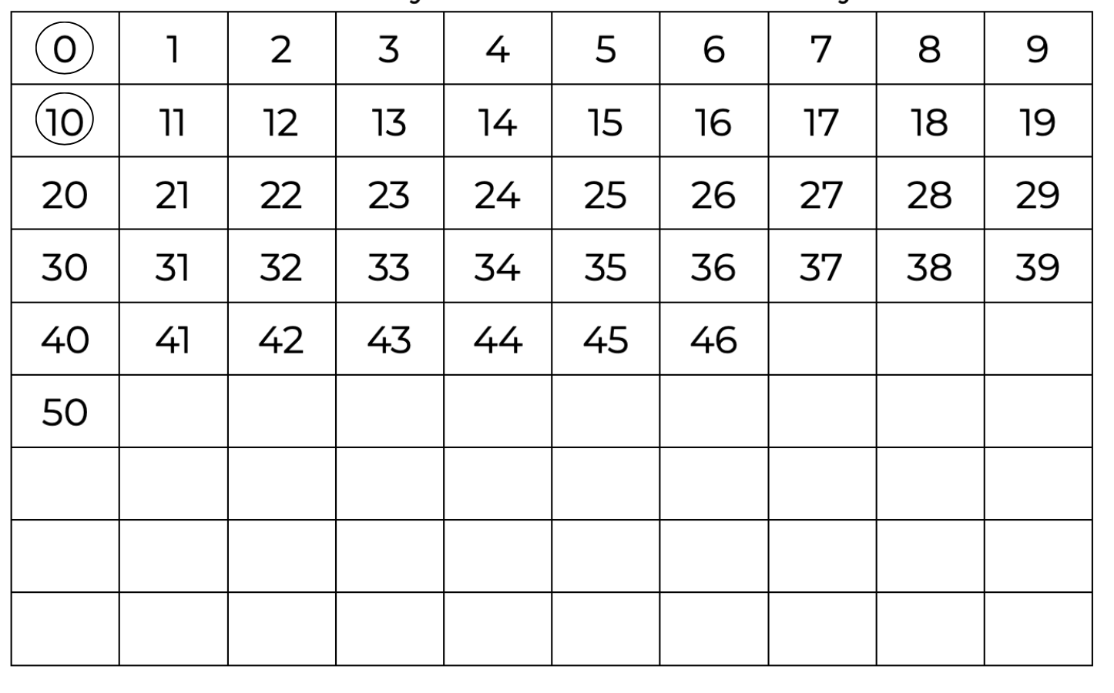
Let’s follow a rule.

Slide 2
Let’s follow a rule. Start at 0 and mark every tenth number.

Slide 3
Let’s follow a rule. Start at 0 and mark every tenth number.

Slide 4
Let’s follow a rule. Start at 0 and mark every tenth number.

Slide 5
Let’s follow a rule. Start at 0 and mark every tenth number.

Slide 6
This is called skip counting.

Slide 7
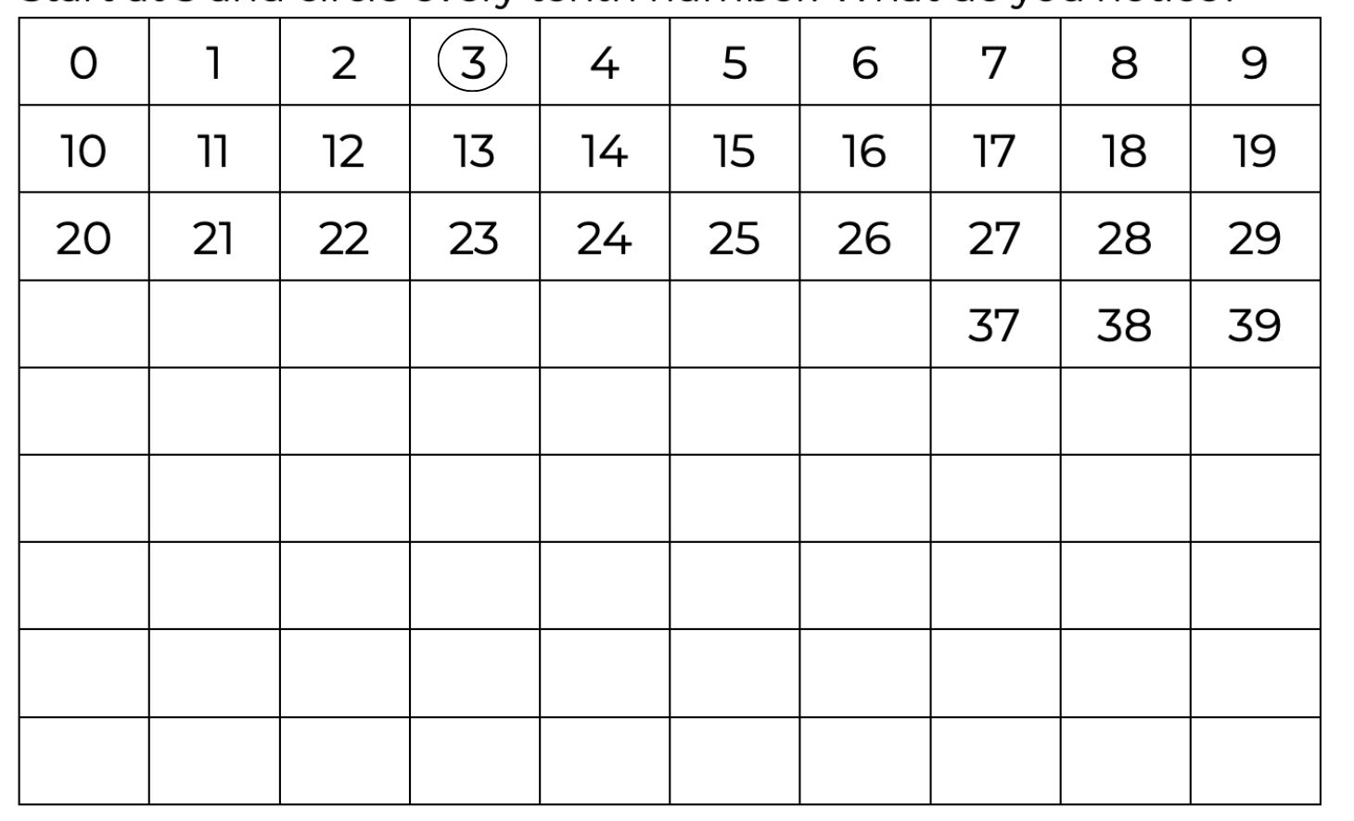
Let’s follow a rule. Start at 3 and mark every tenth number.

Slide 8
Let’s follow a rule. Start at 3 and mark every tenth number.

Slide 9
Let’s follow a rule. Start at 3 and mark every tenth number.

Slide 10
What pattern does this create?

Slide 11
Let’s follow a rule. Start at 7 and mark every tenth number.

Slide 12
Let’s follow a rule. Start at 7 and mark every tenth number.

Slide 13
Let’s follow a rule. Start at 7 and mark every tenth number.

Slide 14
What pattern does this create?

Slide 15
The pattern we can see is that the tens place increases and the ones remain the same.

Slide 16
This pattern helps us to continue skip counting.

Slide 17
This pattern helps us to continue skip counting.
47

Slide 18
This pattern helps us to continue skip counting.
47
57

Slide 19
This pattern helps us to continue skip counting.
47
57
67

Slide 20
Let’s look at the pattern in another way.

Slide 21
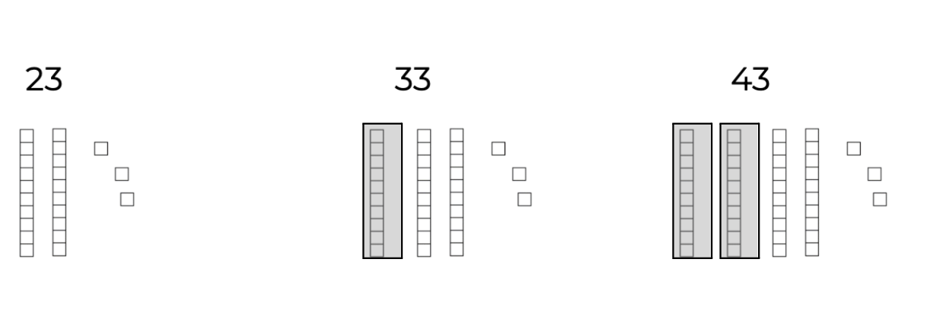
What is repeating?

Slide 22
What is repeating?

Slide 23
What is repeating?
Each time we add a ten.

Slide 24
Skip count by tens

Slide 25
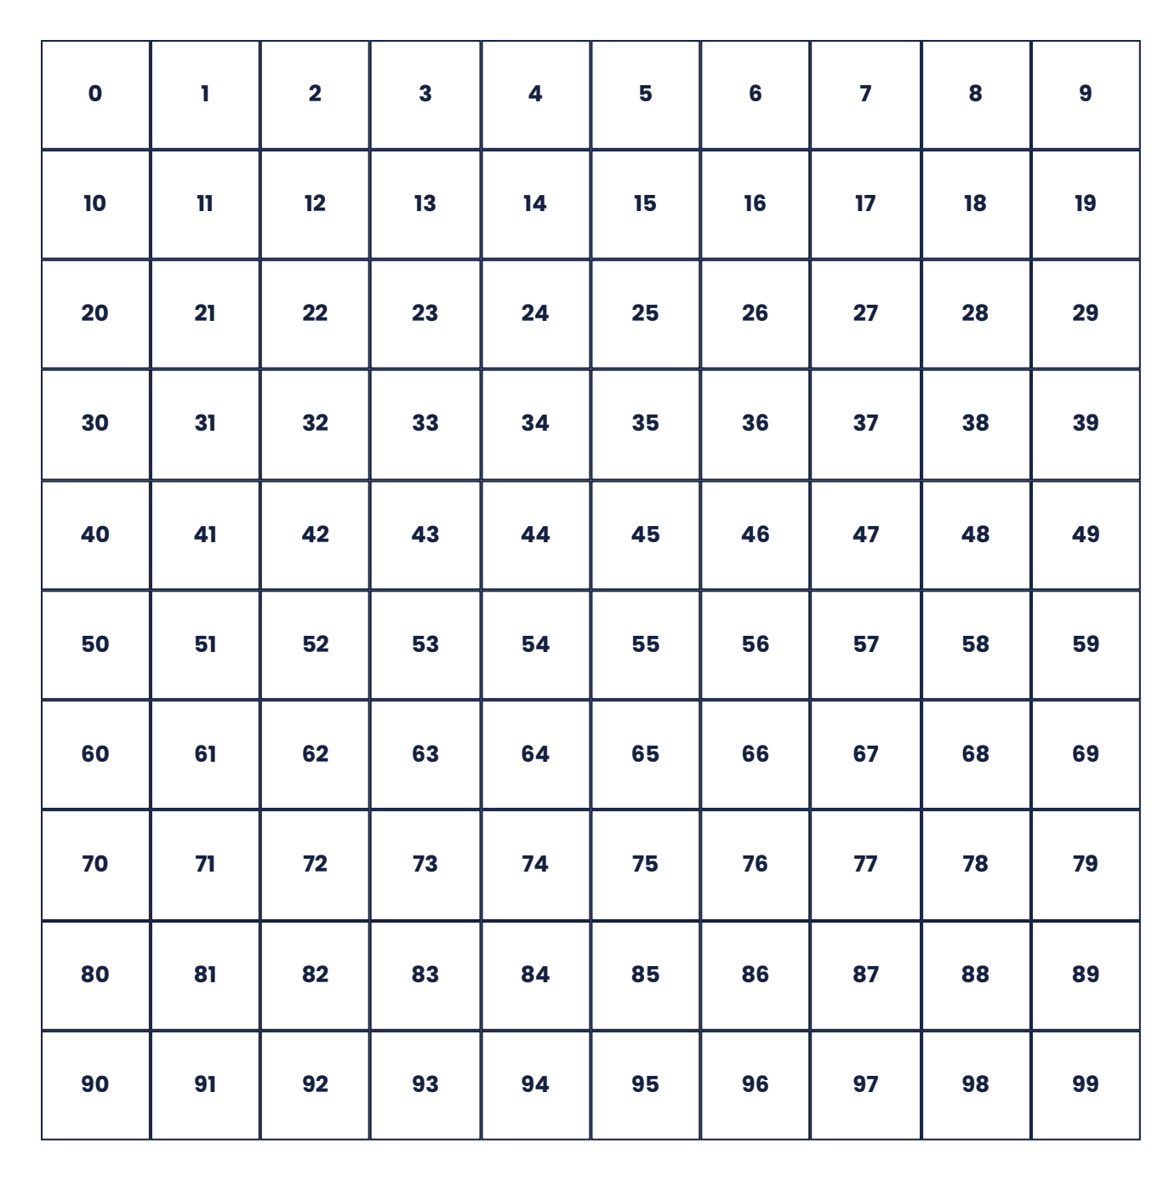
Skip count by tens
10 |  | 30 |  |  | 60

Slide 26
Skip count by tens
10 |  | 30 |  |  | 60

Slide 27
Skip count by tens
20
10 |  | 30 |  |  | 60

Slide 28
Skip count by tens
20
40
10 |  | 30 |  |  | 60

Slide 29
Skip count by tens
20
40
50
10 |  | 30 |  |  | 60

Slide 30
Skip count by tens
20
40
50
70
10 |  | 30 |  |  | 60

Slide 31
Skip count by tens
20
40
50
70
10 |  | 30 |  |  | 60
80

Slide 32
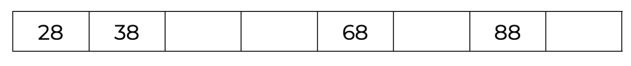
Skip count by tens

Slide 33
Skip count by tens

Slide 34
Skip count by tens
48

Slide 35
Skip count by tens
48
58

Slide 36
Skip count by tens
48
58
78

Slide 37
Skip count by tens
48
58
78
98

Slide 38
Skip count by tens

Slide 39
Skip count by tens

Slide 40
Skip count by tens
29

Slide 41
Skip count by tens
29
39

Slide 42
Skip count by tens
29
39
49

Slide 43
Skip count by tens
29
39
49
59

Slide 44
Skip count by tens
29
39
49
59
69

Slide 45
Skip count by tens
29
39
49
59
69
79

