Slide 1
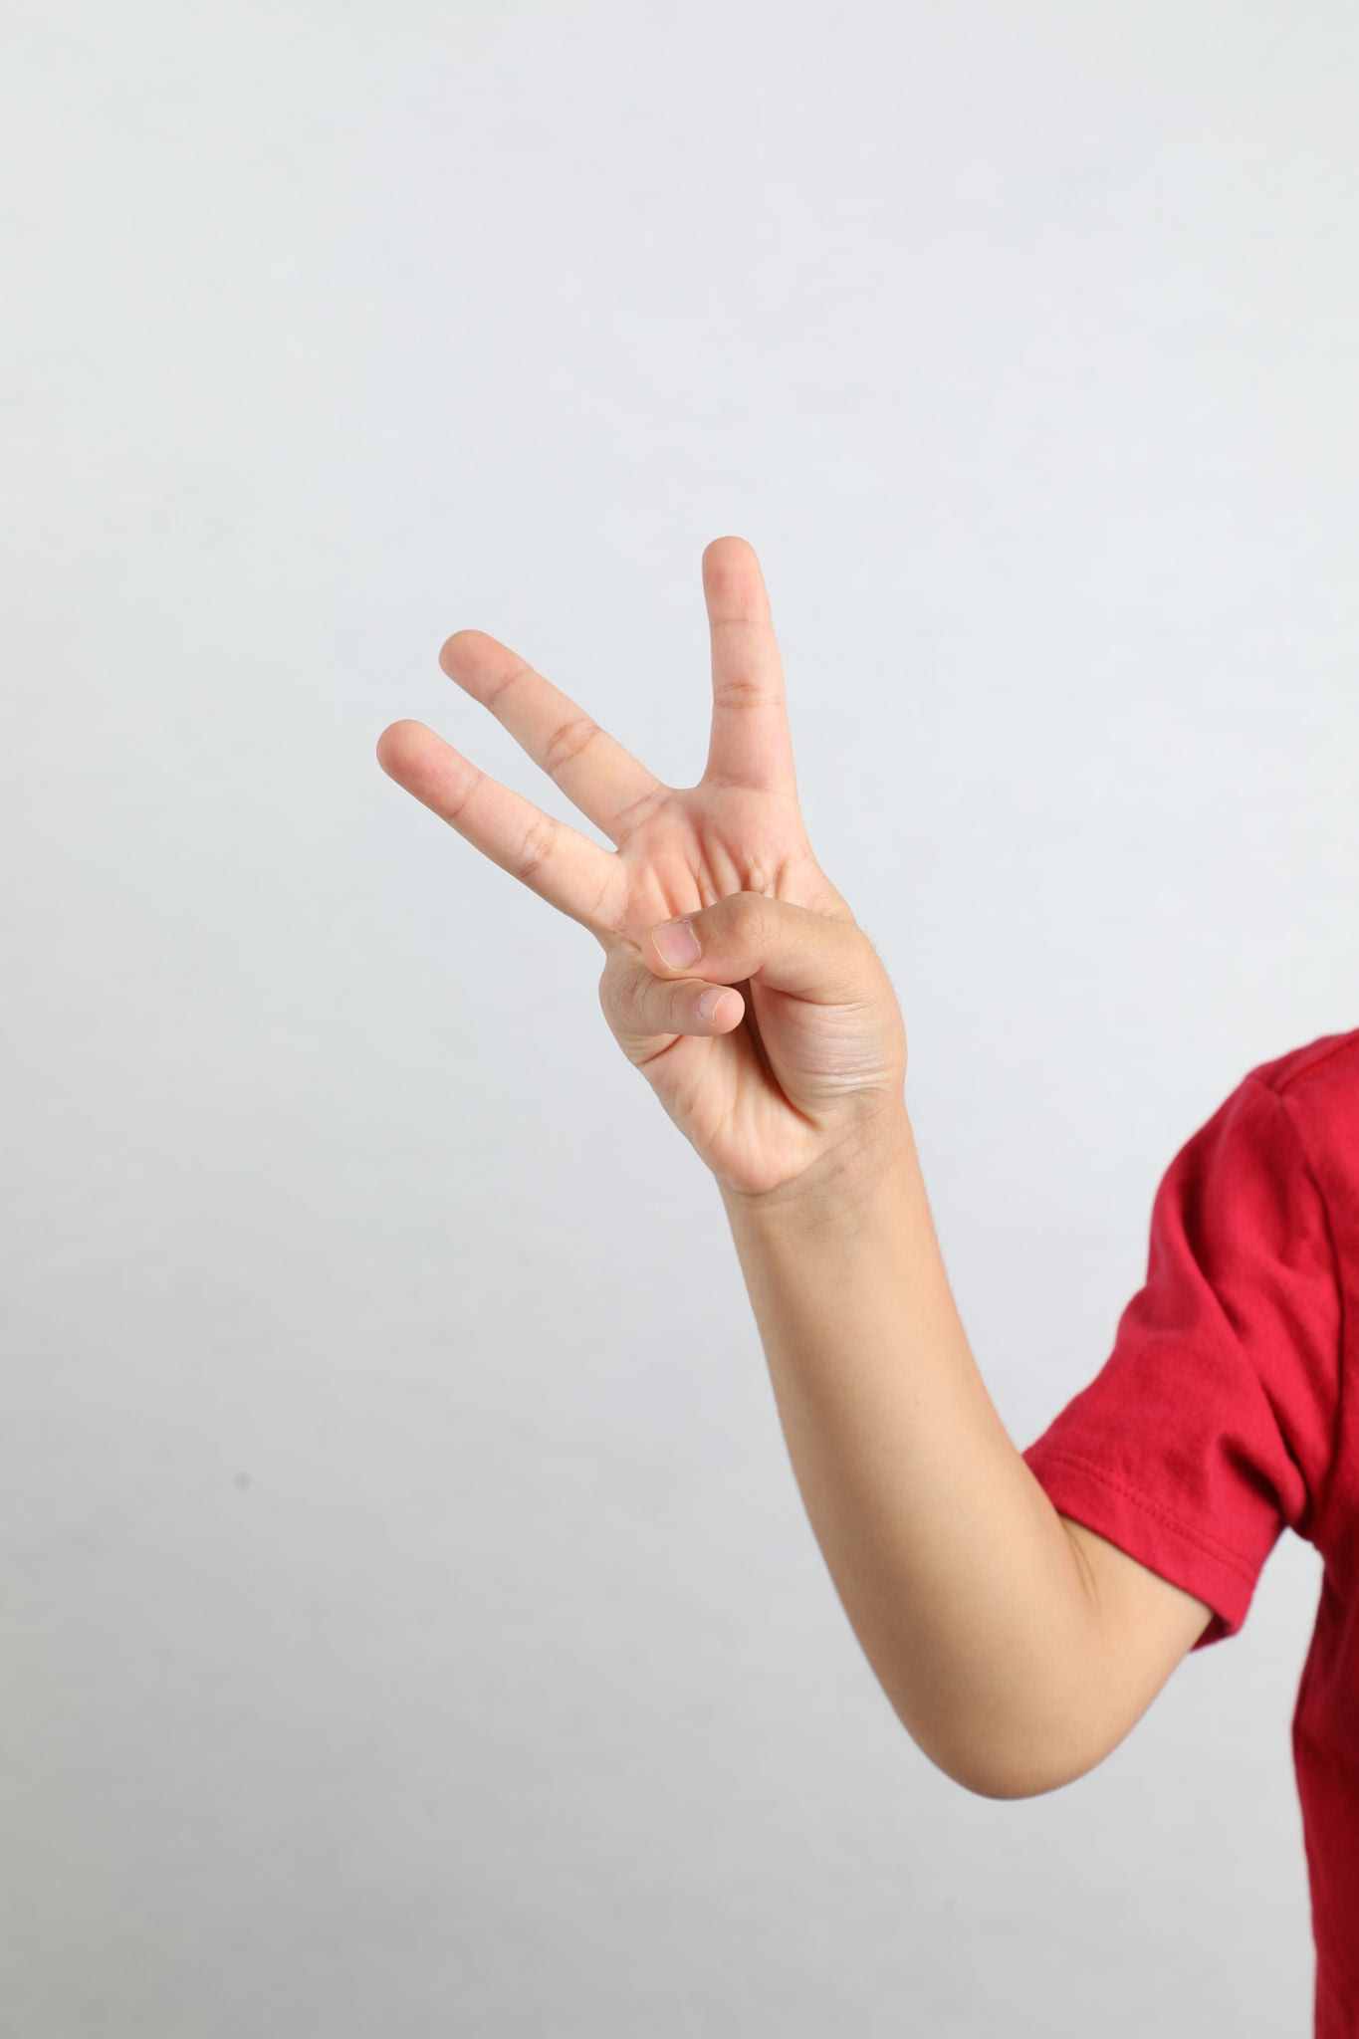
How many fingers am I holding up?

Slide 2
I am holding up 3 fingers

Slide 3
I am holding up 3 fingers

Slide 4
I am holding up 3 fingers

Slide 5
I am holding up 3 fingers

Slide 6
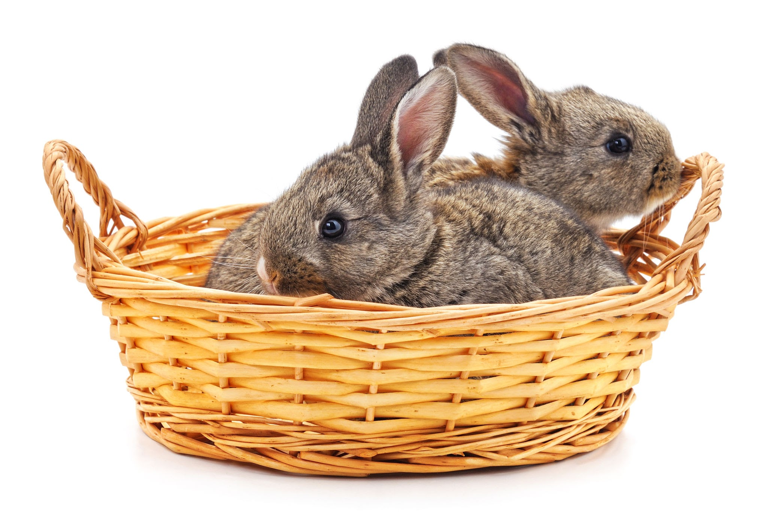
How many rabbits are in the basket?

Slide 7
There are 2 rabbits in the basket

Slide 8
There are 2 rabbits in the basket

Slide 9
There are 2 rabbits in the basket

Slide 10
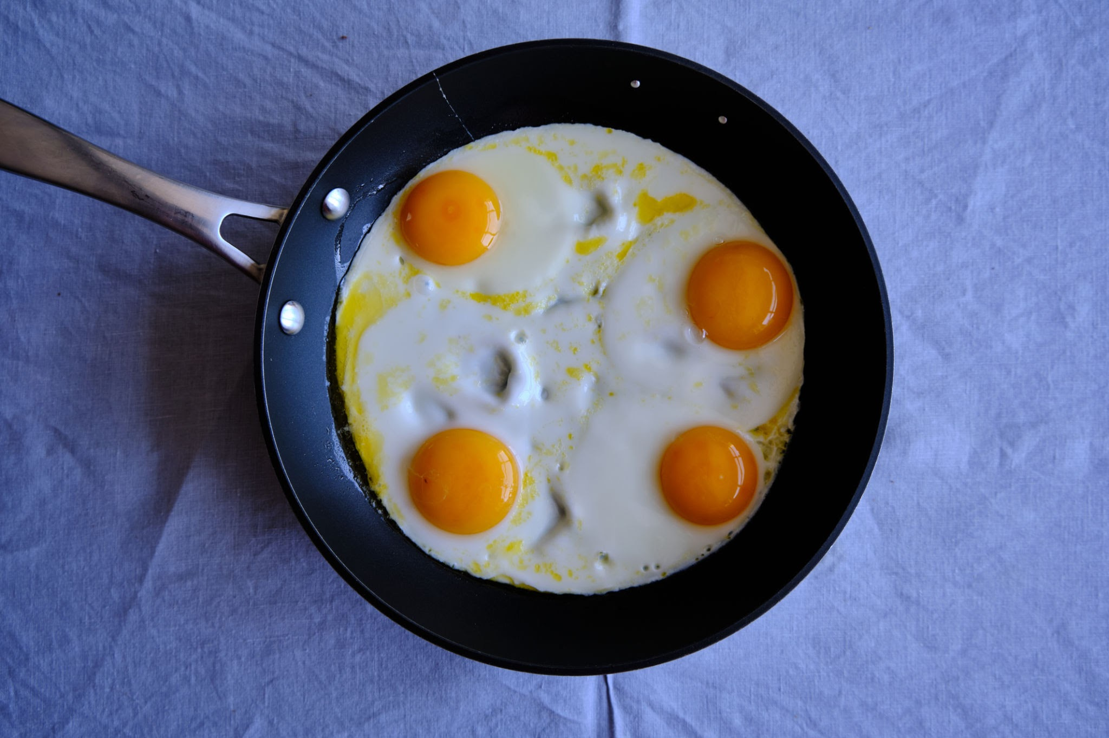
How many eggs are in the pan?

Slide 11
There are 4 eggs are in the pan

Slide 12
There are 4 eggs are in the pan

Slide 13
There are 4 eggs are in the pan

Slide 14
There are 4 eggs are in the pan

Slide 15
There are 4 eggs are in the pan

Slide 16
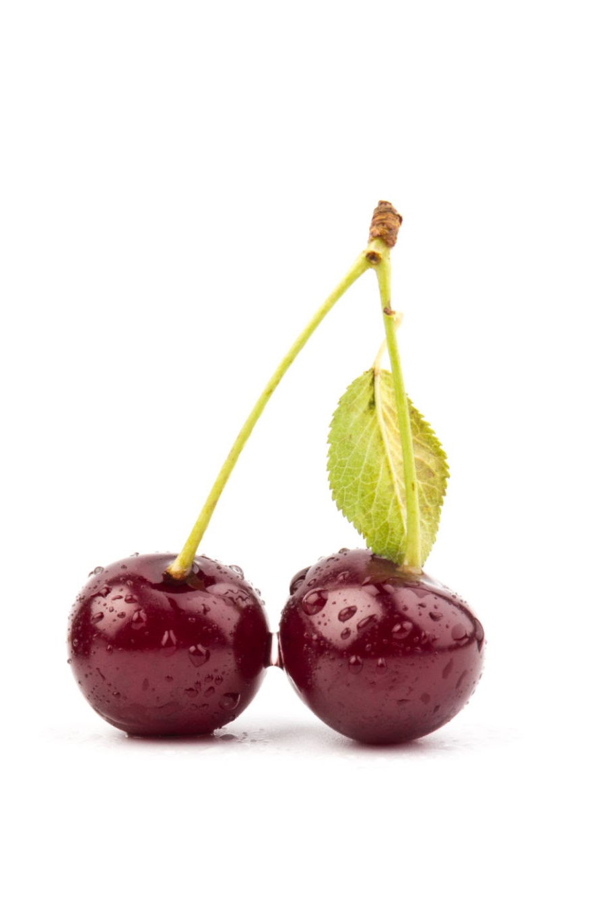
How many cherries are in the bunch?

Slide 17
There are 2 cherries are in the bunch

Slide 18
There are 2 cherries are in the bunch

Slide 19
There are 2 cherries are in the bunch

Slide 20
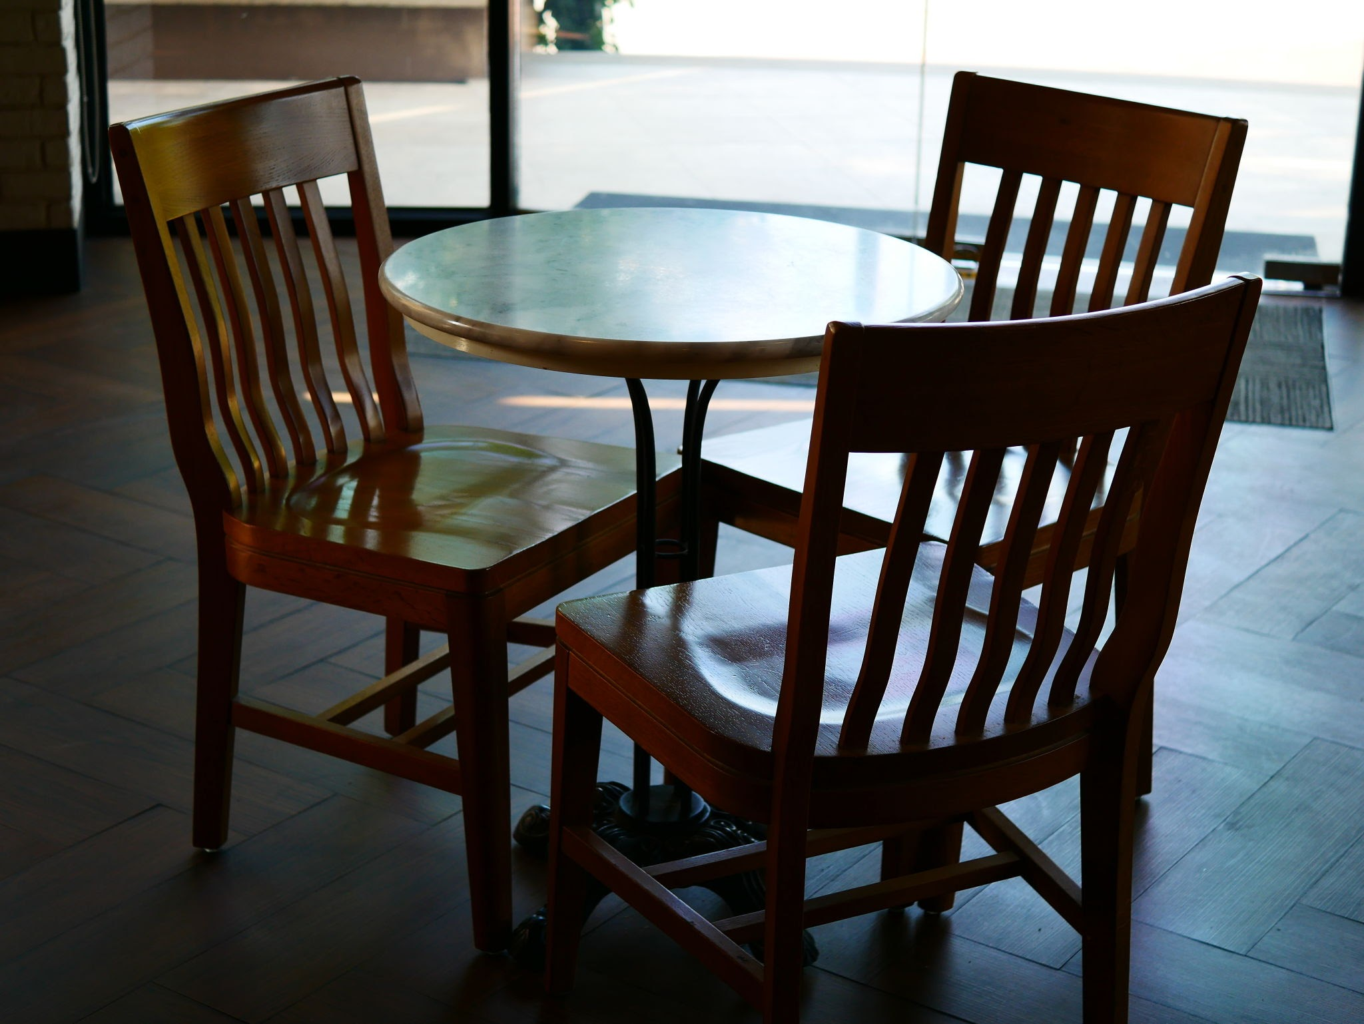
How many chairs are at the table?

Slide 21
There are 3 chairs are at the table

Slide 22
There are 3 chairs are at the table

Slide 23
There are 3 chairs are at the table

Slide 24
There are 3 chairs are at the table

Slide 25
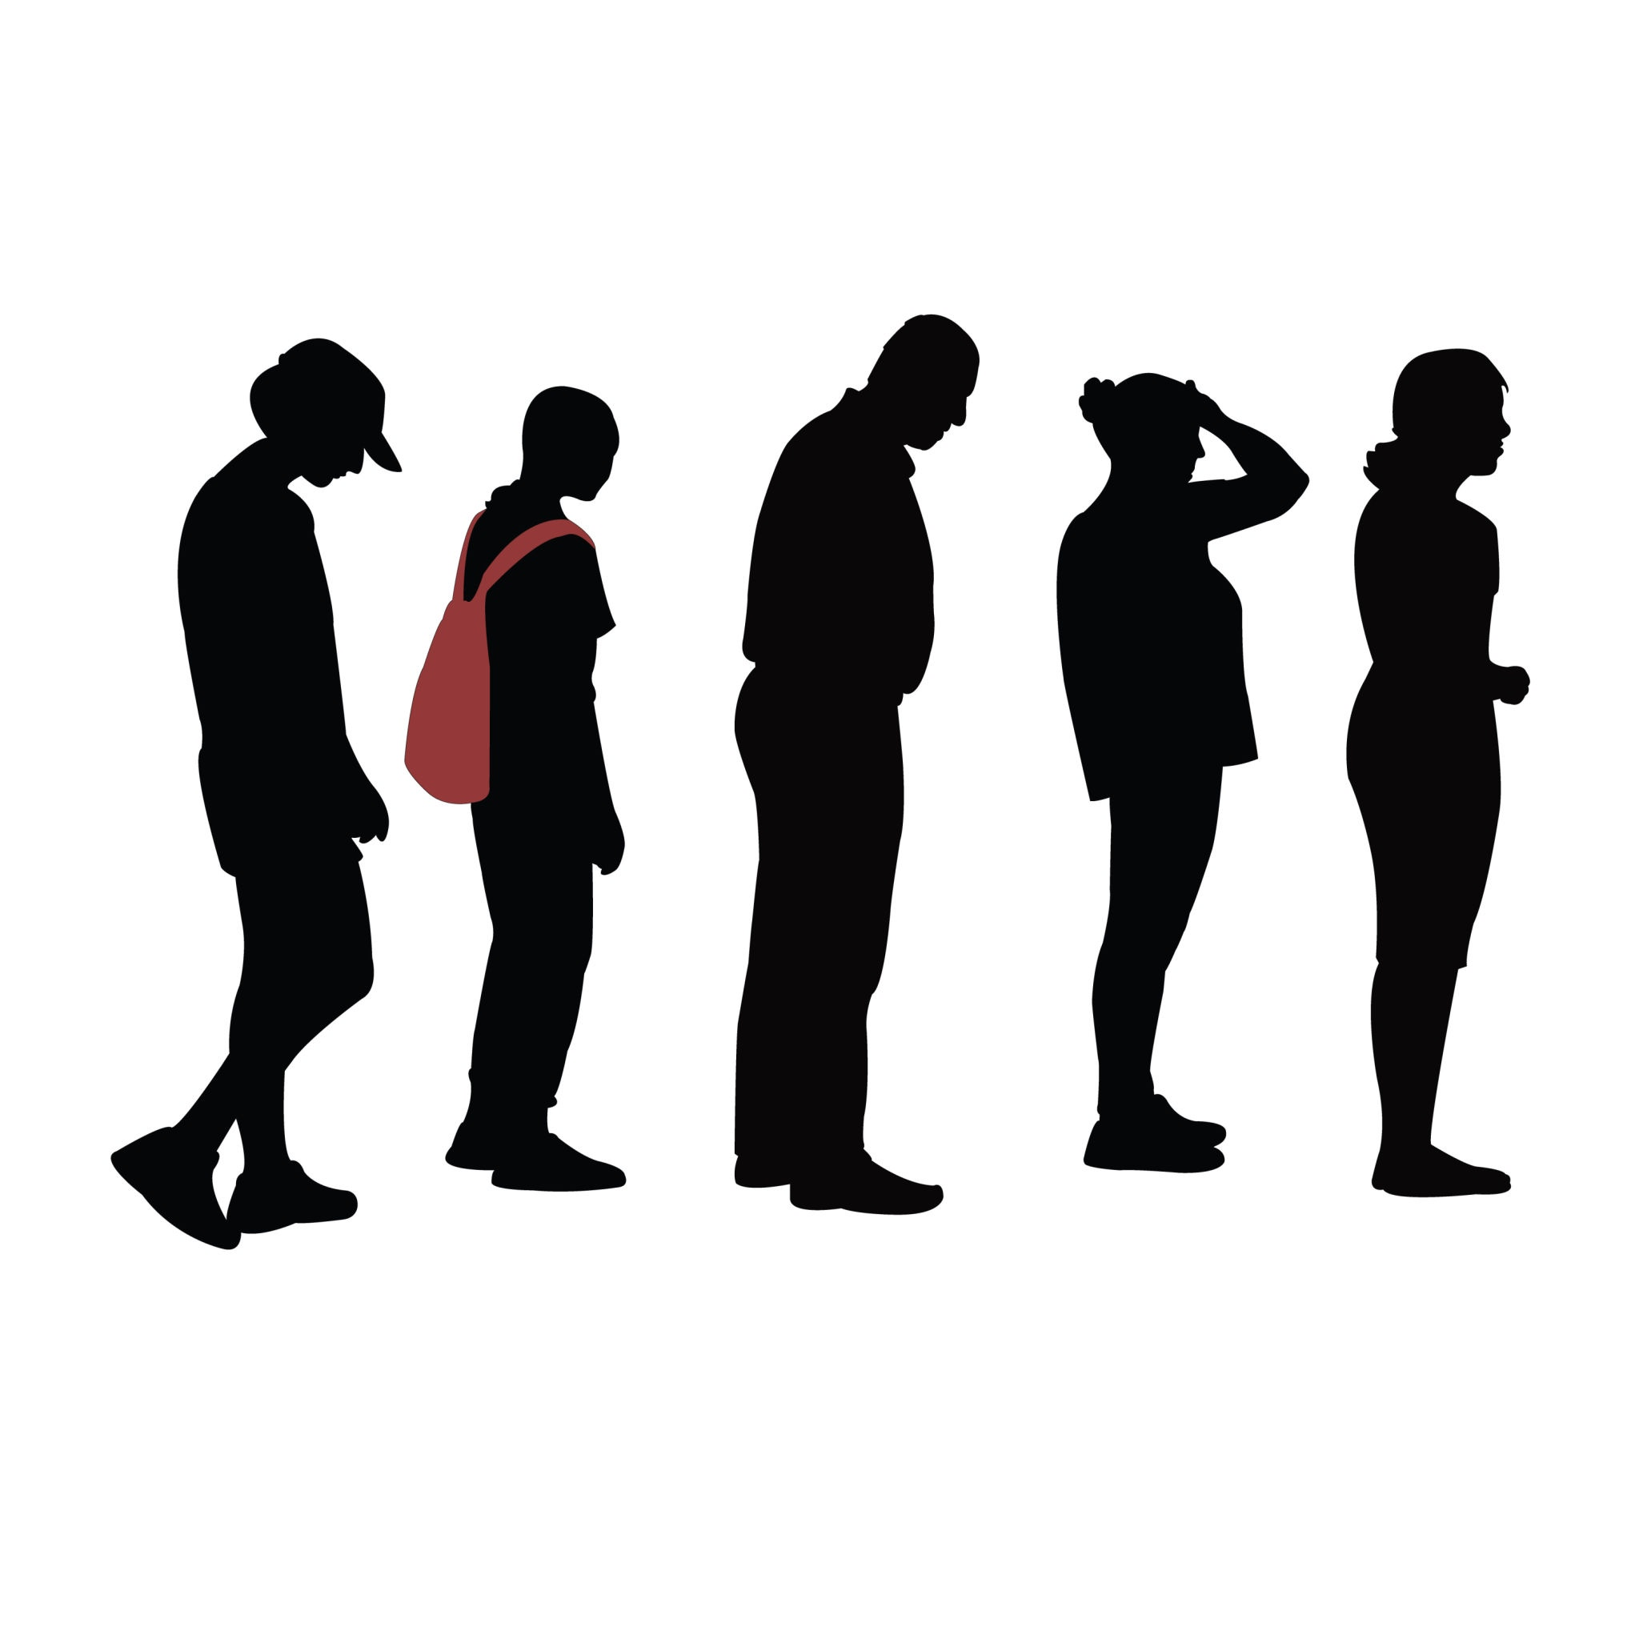
How many people are waiting to get in?

Slide 26
There are 5 people waiting to get in

Slide 27
There are 5 people waiting to get in

Slide 28
There are 5 people waiting to get in

Slide 29
There are 5 people waiting to get in

Slide 30
There are 5 people waiting to get in

Slide 31
There are 5 people waiting to get in

Slide 32
Close the group

Slide 33
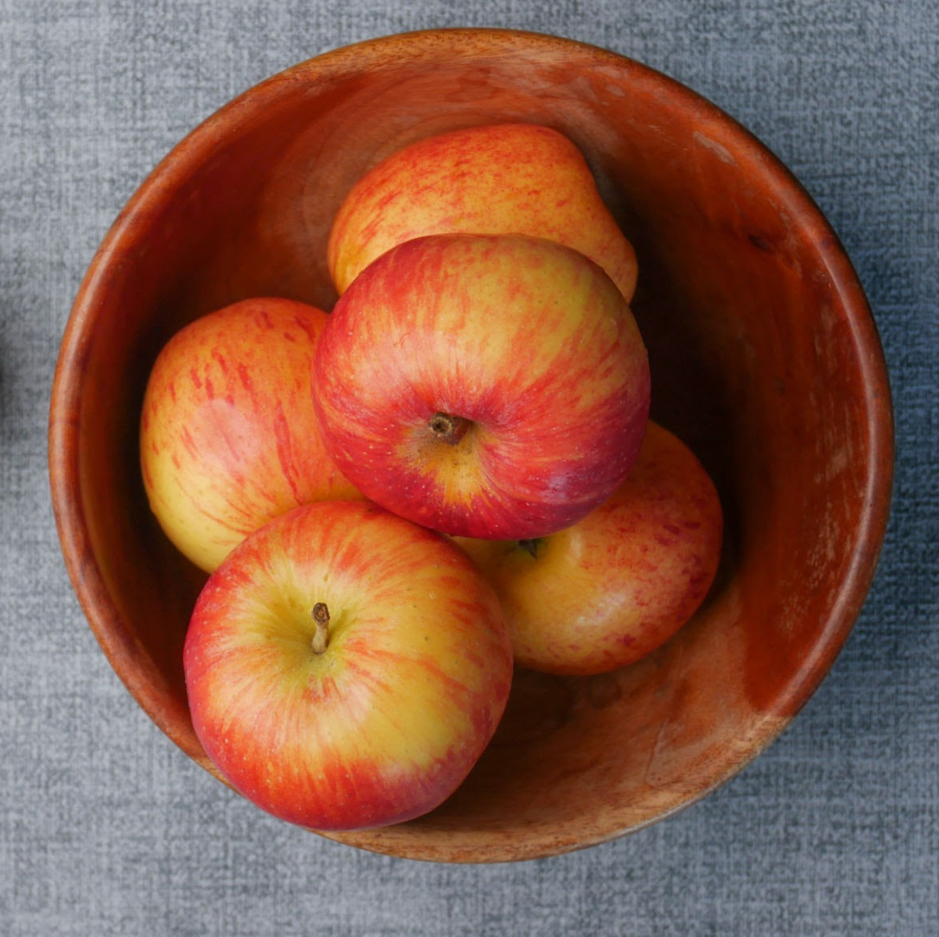
How many apples are in the bowl?

Slide 34
There are 5 apples are in the bowl

Slide 35
There are 5 apples are in the bowl

Slide 36
There are 5 apples are in the bowl

Slide 37
There are 5 apples are in the bowl

Slide 38
There are 5 apples are in the bowl

Slide 39
There are 5 apples are in the bowl

Slide 40
Close the group

Slide 41
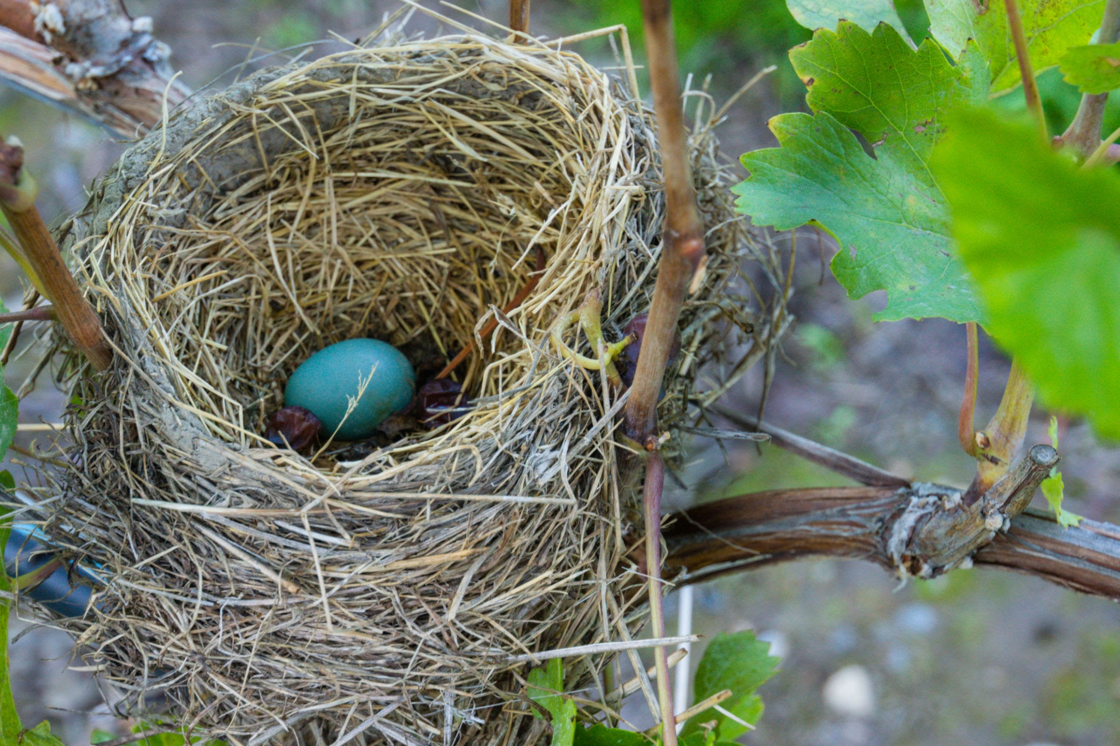
How many eggs are in the nest?

Slide 42
There is 1 egg in the nest

Slide 43
There is 1 egg in the nest

Slide 44
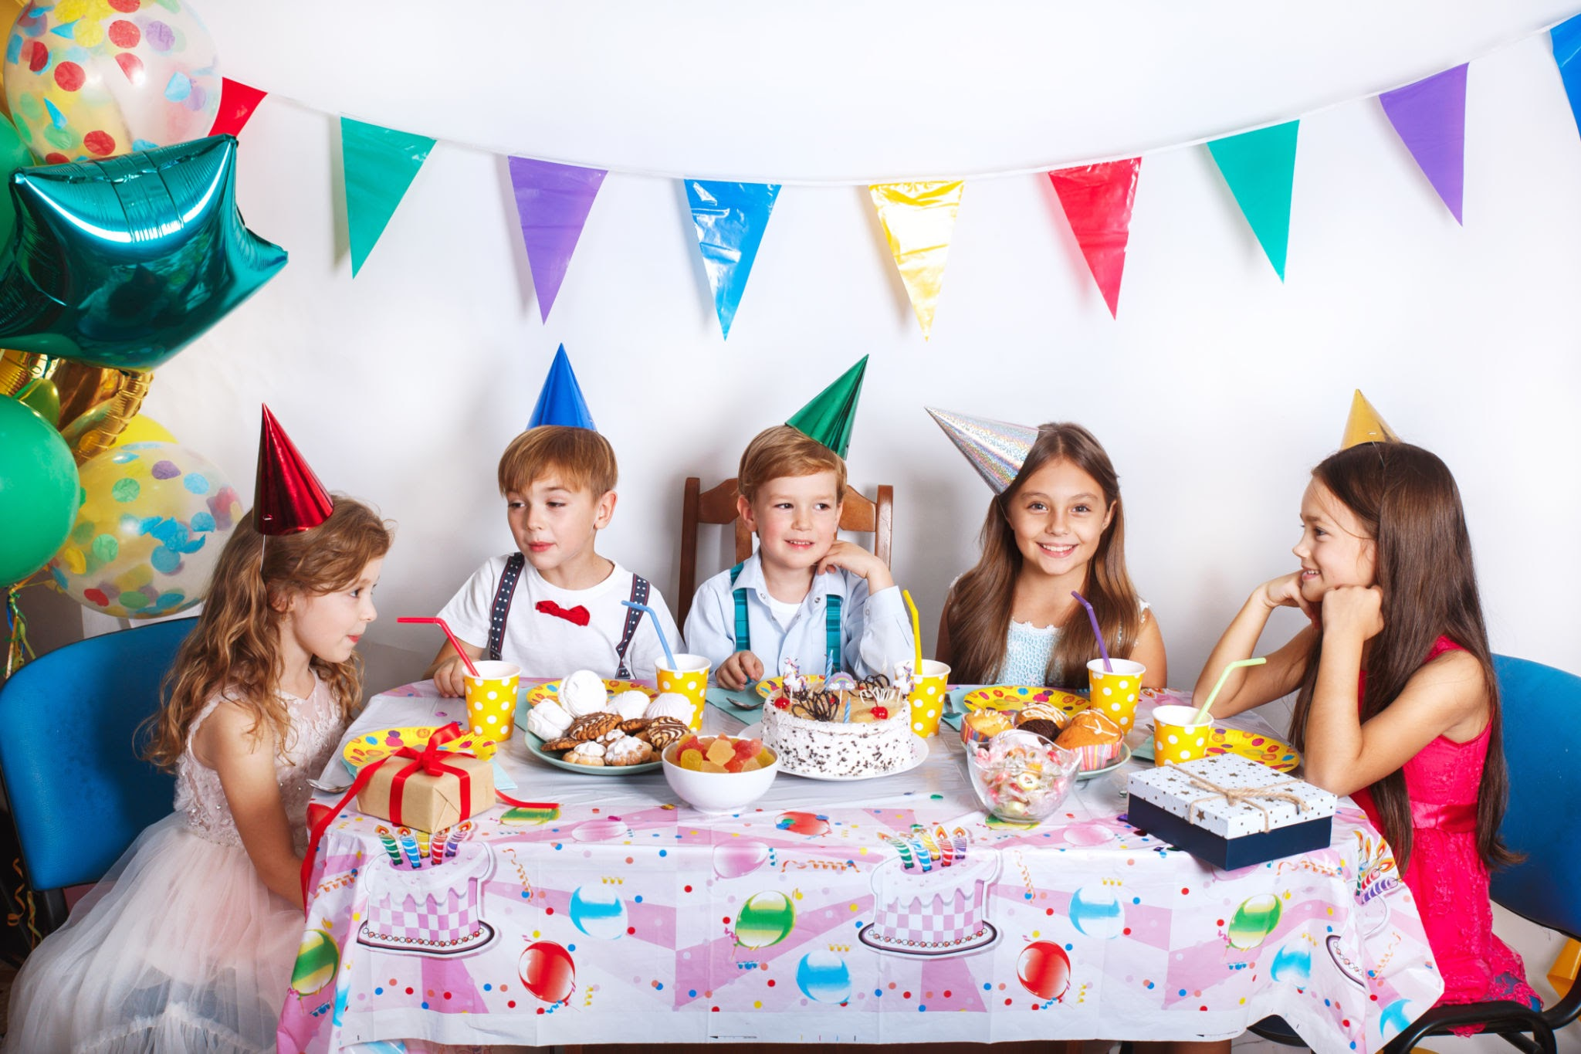
How many children are at this party?

Slide 45
There are 5 children at this party

Slide 46
There are 5 children at this party

Slide 47
There are 5 children at this party

Slide 48
There are 5 children at this party

Slide 49
There are 5 children at this party

Slide 50
There are 5 children at this party

Slide 51
Close the group

