Slide 1
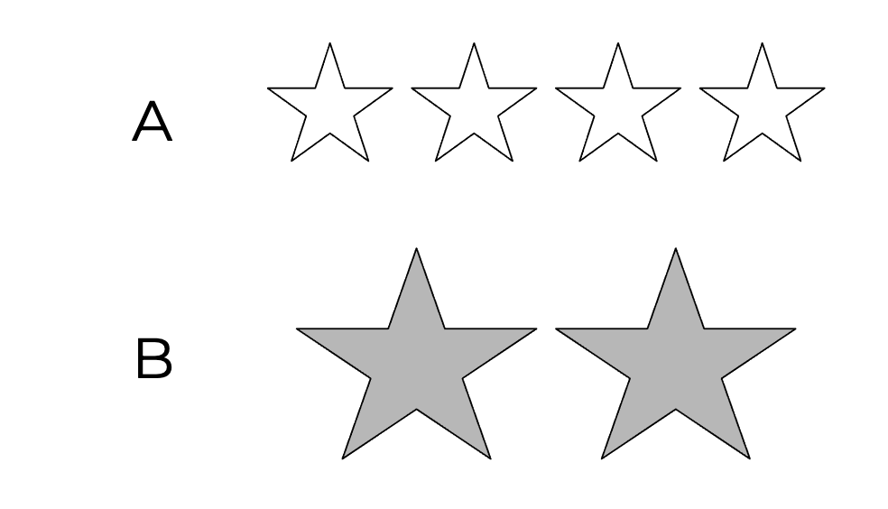

Slide 2
Let’s think of words to describe the groups of stars

Slide 3
Words for review: more
How many
More
Greater
Larger (number)
Bigger (number)
Size, space, length
Taller
Wider
Bigger (size)
Longer
Higher

Slide 4
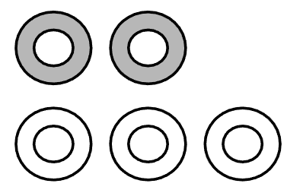
Words for review: equal
How many
Equal (number)
Same (number)
Even (number)
Size, space, length
Equal (size, length)
Same (size, length)
Even (size, length)

Slide 5
Words for review: less
How many
Fewer
Less
Smaller (number)
Size, space, length
Smaller (size)
Shorter
Little

Slide 6
Which group has more?
A
B

Slide 7
Which group has less?
A
B

Slide 8
Are these groups equal?
A
B

Slide 9
Which group has less?
A
B

Slide 10
Which group has more?
A
B

Slide 11
Are these groups equal?
A
B

Slide 12
Which group has fewer?
A
B

Slide 13
Does one group have fewer?
A
B

Slide 14
Which terms can be used to describe how many?
More Greater Equal (number of)
Fewer Shorter Larger (number of)
Even (number of) Smaller (size) Less
Even (size, length) Same (number of) Wider
Longer Bigger (number of) Same (size, length)
Taller Smaller (number of) Little
Higher Bigger (size) Equal (size, length)

Slide 15
Which terms can be used to describe how many?
More Greater Equal (number of)
Fewer Shorter Larger (number of)
Even (number of) Smaller (size) Less
Even (size, length) Same (number of) Wider
Longer Bigger (number of) Same (size, length)
Taller Smaller (number of) Little
Higher Bigger (size) Equal (size, length)

Slide 16
Which terms can be used to describe size, space, length?
More Greater Equal (number of)
Fewer Shorter Larger (number of)
Even (number of) Smaller (size) Less
Even (size, length) Same (number of) Wider
Longer Bigger (number of) Same (size, length)
Taller Smaller (number of) Little
Higher Bigger (size) Equal (size, length)

Slide 17
Which terms can be used to describe size, space, length?
More Greater Equal (number of)
Fewer Shorter Larger (number of)
Even (number of) Smaller (size) Less
Even (size, length) Same (number of) Wider
Longer Bigger (number of) Same (size, length)
Taller Smaller (number of) Little
Higher Bigger (size) Equal (size, length)

