Slide 1
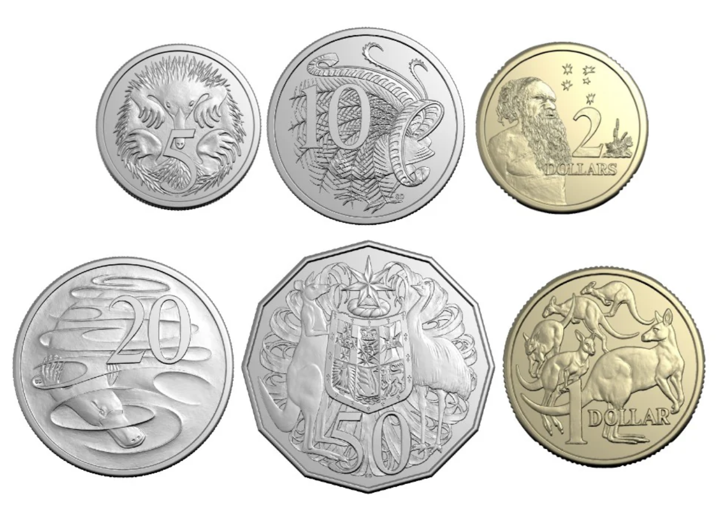
What coin is this?

Slide 2
What coin is this?
1 dollar

Slide 3
What coin is this?
1 dollar
$1

Slide 4
What coin is this?

Slide 5
What coin is this?
2 dollars

Slide 6
What coin is this?
2 dollars
$2

Slide 7
One dollar is equal to 100 cents

Slide 8
Let’s come up with some ways to make one dollar
=

Slide 9
One dollar is the same as 50 cents and 50 cents
=

Slide 10
One dollar is the same as five 20 cent coins
=

Slide 11
Two dollars is equal to two one dollars

Slide 12
Two dollars is equal to two one dollars
=

Slide 13
Let’s come up with some other ways to make two dollars
=

Slide 14
Two dollars is one dollar coin and two fifty cent coins
=

Slide 15
Two dollars is
=

