Slide 1
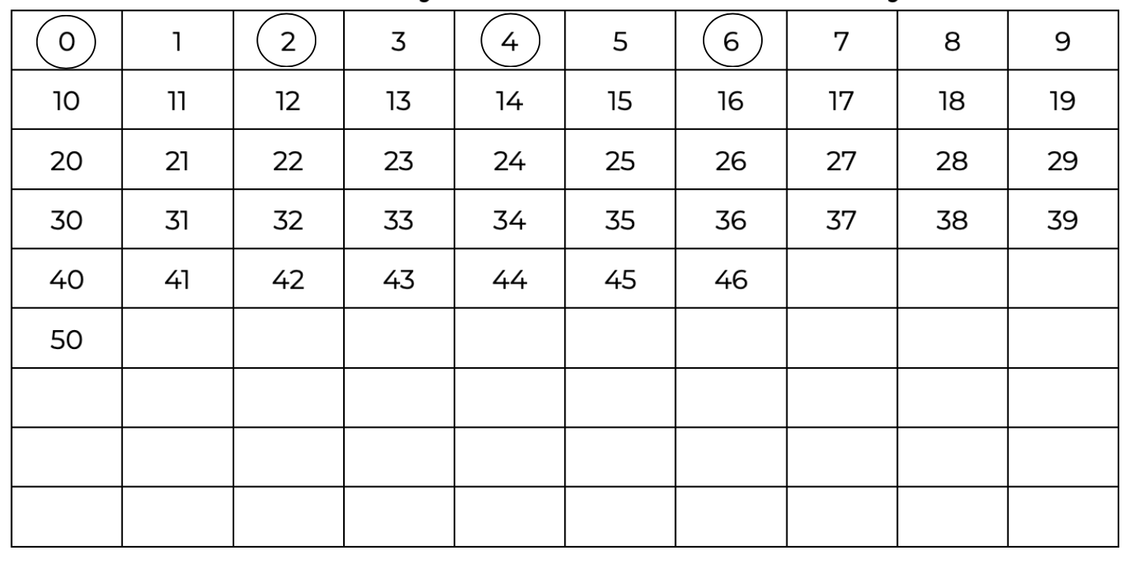
Let’s follow a rule.

Slide 2
Let’s follow a rule. Start at 0 and mark every second number.

Slide 3
Let’s follow a rule. Start at 0 and mark every second number.

Slide 4
Let’s follow a rule. Start at 0 and mark every second number.

Slide 5
Let’s follow a rule. Start at 0 and mark every second number.

Slide 6
Let’s follow a rule. Start at 0 and mark every second number.

Slide 7
Let’s follow a rule. Start at 0 and mark every second number.

Slide 8
Let’s follow a rule. Start at 0 and mark every second number.

Slide 9
Let’s follow a rule. Start at 0 and mark every second number.

Slide 10
Let’s follow a rule. Start at 0 and mark every second number.

Slide 11
Let’s follow a rule. Start at 0 and mark every second number.

Slide 12
Let’s follow a rule. Start at 0 and mark every second number.

Slide 13
What can you see happening?

Slide 14
There is a pattern.

Slide 15
There is a pattern.

Slide 16
There is a pattern.

Slide 17
There is a pattern.

Slide 18
There is a pattern.

Slide 19
All of the numbers end in 0 2 4 6 8

Slide 20
All of the numbers end in 0 2 4 6 8 Then the tens place changes

Slide 21
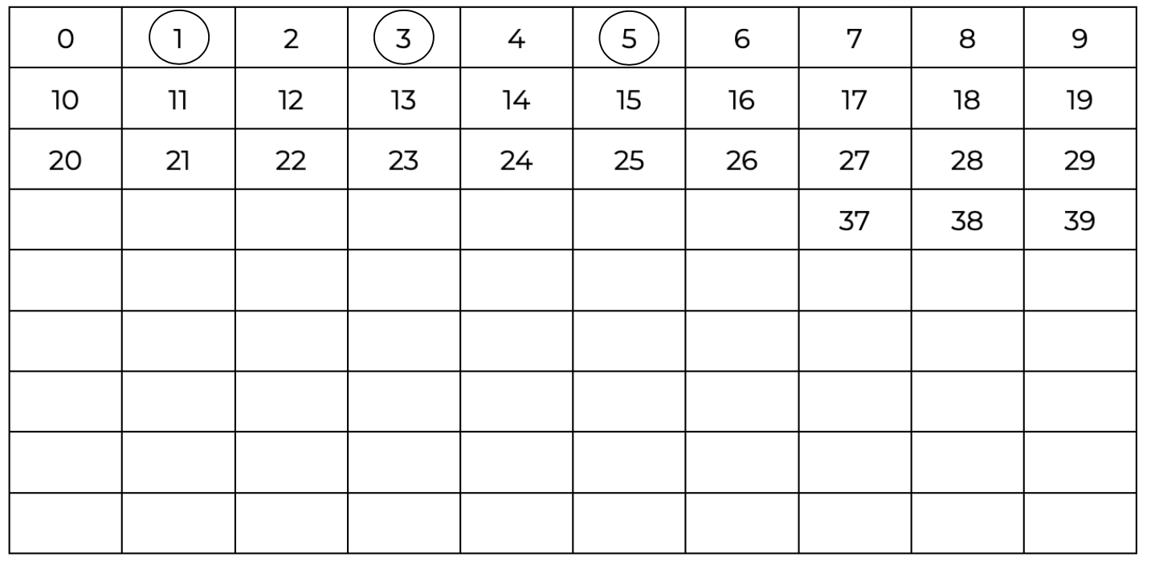
Let’s follow a rule.

Slide 22
Let’s follow a rule. Start at 1 and mark every second number.

Slide 23
Let’s follow a rule. Start at 1 and mark every second number.

Slide 24
Let’s follow a rule. Start at 1 and mark every second number.

Slide 25
Let’s follow a rule. Start at 1 and mark every second number.

Slide 26
Let’s follow a rule. Start at 1 and mark every second number.

Slide 27
Let’s follow a rule. Start at 1 and mark every second number.

Slide 28
Let’s follow a rule. Start at 1 and mark every second number.

Slide 29
Let’s follow a rule. Start at 1 and mark every second number.

Slide 30
Let’s follow a rule. Start at 1 and mark every second number.

Slide 31
Let’s follow a rule. Start at 1 and mark every second number.

Slide 32
Let’s follow a rule. Start at 1 and mark every second number.

Slide 33
Let’s follow a rule. Start at 1 and mark every second number.

Slide 34
Let’s follow a rule. Start at 1 and mark every second number.

Slide 35
What can you see happening?

Slide 36
There is a pattern.

Slide 37
All of the numbers end in 1 3 5 7 9

Slide 38
All of the numbers end in 1 3 5 7 9 Then the tens place changes

Slide 39
All of the numbers end in 1 3 5 7 9 Then the tens place changes

Slide 40
What next?

Slide 41
What next?

Slide 42
What next?
31

Slide 43
Skip count by 2

Slide 44
Skip count by 2
4

Slide 45
Skip count by 2
4
8

Slide 46
Skip count by 2
4
8
10

Slide 47
Skip count by 2
4
8
10
14

Slide 48
Skip count by 2
4
8
10
14
16

Slide 49
Skip count by 2

Slide 50
Skip count by 2
31

Slide 51
Skip count by 2
31
33

Slide 52
Skip count by 2
31
33
37

Slide 53
Skip count by 2
31
33
37
41

Slide 54
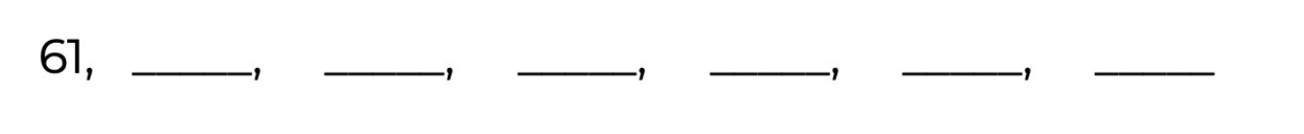
Skip count by 2

Slide 55
Skip count by 2
63

Slide 56
Skip count by 2
63
65

Slide 57
Skip count by 2
63
65
67

Slide 58
Skip count by 2
63
65
67
69

Slide 59
Skip count by 2
63
65
67
69
71

Slide 60
Skip count by 2
63
65
67
69
71
73

Slide 61
Draw a number line starting at 10 with intervals of 2

Slide 62
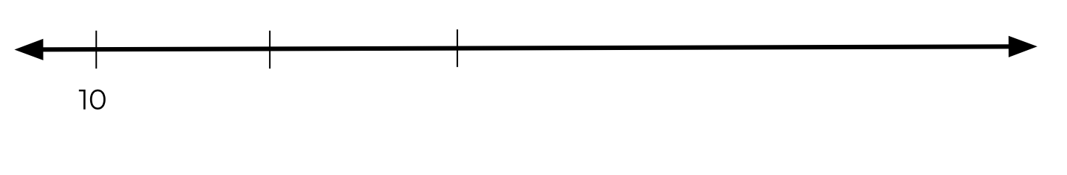
Draw a number line starting at 10 with intervals of 2

Slide 63
Draw a number line starting at 10 with intervals of 2

Slide 64
Draw a number line starting at 10 with intervals of 2
2

Slide 65
Draw a number line starting at 10 with intervals of 2
2
12

Slide 66
Draw a number line starting at 10 with intervals of 2
12

Slide 67
Draw a number line starting at 10 with intervals of 2
2
12

Slide 68
Draw a number line starting at 10 with intervals of 2
2
12
14

Slide 69
Draw a number line starting at 10 with intervals of 2
12
14

Slide 70

Draw a number line starting at 10 with intervals of 2
12
14

Slide 71
Draw a number line starting at 10 with intervals of 2
12
14
16
18

