Slide 1
Language
part
whole
missing part
Part Part Whole Model

Slide 2
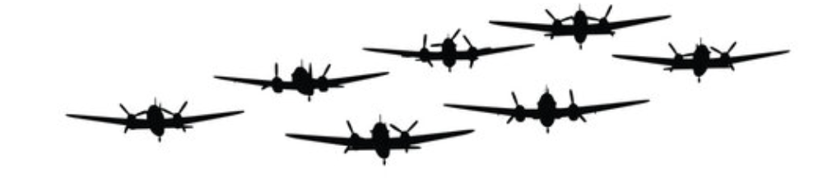
There was a group of planes flying

Slide 3
Some flew behind the clouds

Slide 4
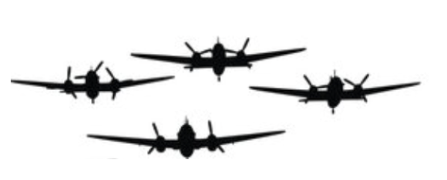
You could still see some

Slide 5
Label the whole and the two parts

Slide 6
whole
part
part

Slide 7
How many planes went behind the clouds?
whole
part
part

Slide 8
How many planes went behind the clouds?
whole
7
4
part
part

Slide 9
How many planes went behind the clouds?
whole
7
3
4
part
part

Slide 10
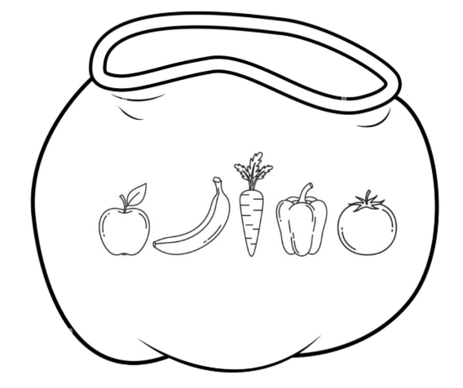
There was a bag of fruit and vegetables.

Slide 11

There was a bag of fruit and vegetables.
Some fell out and 2 were left in the bag.

Slide 12
Can we draw this as a bar model?

Slide 13
There was a bag of fruit and vegetables.
Some fell out and 2 were left in the bag.

Slide 14
There was a bag of fruit and vegetables.
Some fell out and 2 were left in the bag.

Slide 15
There was a bag of fruit and vegetables.
Some fell out and 2 were left in the bag.

Slide 16
whole
part
part

Slide 17
How many fell out?
whole
part
part

Slide 18
How many fell out?
whole
part
part
5

Slide 19
How many fell out?
whole
part
part
5
2

Slide 20
How many fell out?
whole
part
part
5
3
2

Slide 21

What is the missing part?
whole
6
part
part
2

Slide 22
What is the missing part?
whole
6
part
part
2
4

Slide 23
What is the missing part?
part
part
3

Slide 24
What is the missing part?
part
part
3
3

Slide 25
What is the missing part?
whole
5
part
part
2

Slide 26
What is the missing part?
whole
5
part
part
3
2

Slide 27

What is the missing part?
whole
10
part
part
9

Slide 28
What is the missing part?
whole
10
part
part
1
9

Slide 29
What is the missing part?
whole
10
part
part
3

Slide 30
What is the missing part?
whole
10
part
part
3
6

Slide 31
What is the missing part?
whole
10
part
part
5

Slide 32
What is the missing part?
whole
10
part
part
5
5

Slide 33
whole
part
part

Slide 34
whole
part
part

Slide 35
whole
part
part

Slide 36
whole
part
part

Slide 37
whole
part
part

Slide 38
whole
part
part

Slide 39
whole
part
part

Slide 40
whole
part
part

Slide 41
whole
part
part

