Slide 1
Count forwards

Slide 2


Slide 8
Count backwards

Slide 15
Count forwards

Slide 16
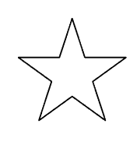

Slide 21
Count backwards

Slide 28
Count backwards

Slide 35
Count backwards

Slide 42
Count backwards

Slide 47
Count backwards

Slide 53
Count backwards

Slide 54
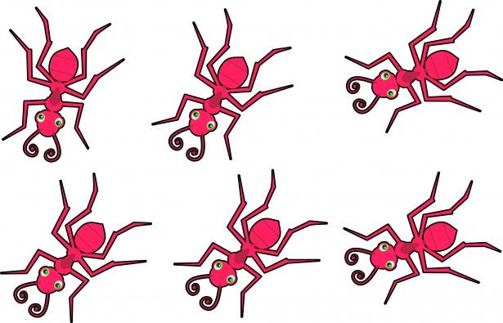

Slide 57
Count backwards

Slide 58
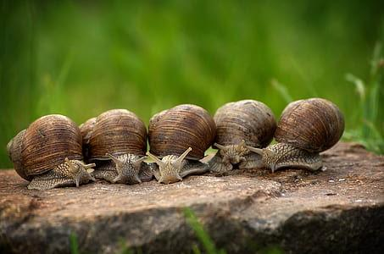

Slide 63
Let’s go forwards and then backwards
1

Slide 64

Let’s go forwards (up)
1

Slide 65
Let’s go forwards (up)
1

Slide 66
Let’s go forwards (up)
1

Slide 67
Let’s go forwards (up)
1

Slide 68
Let’s go forwards (up)
1

Slide 69
Let’s go forwards (up)

Slide 70
Let’s go forwards (up)

Slide 71
And backwards (down)

Slide 72
And backwards (down)

Slide 73
And backwards (down)

Slide 74
And backwards (down)

Slide 75
And backwards (down)

Slide 76
And backwards (down)

Slide 77
Let’s go forwards (up)

Slide 78
Let’s go forwards (more)

Slide 79
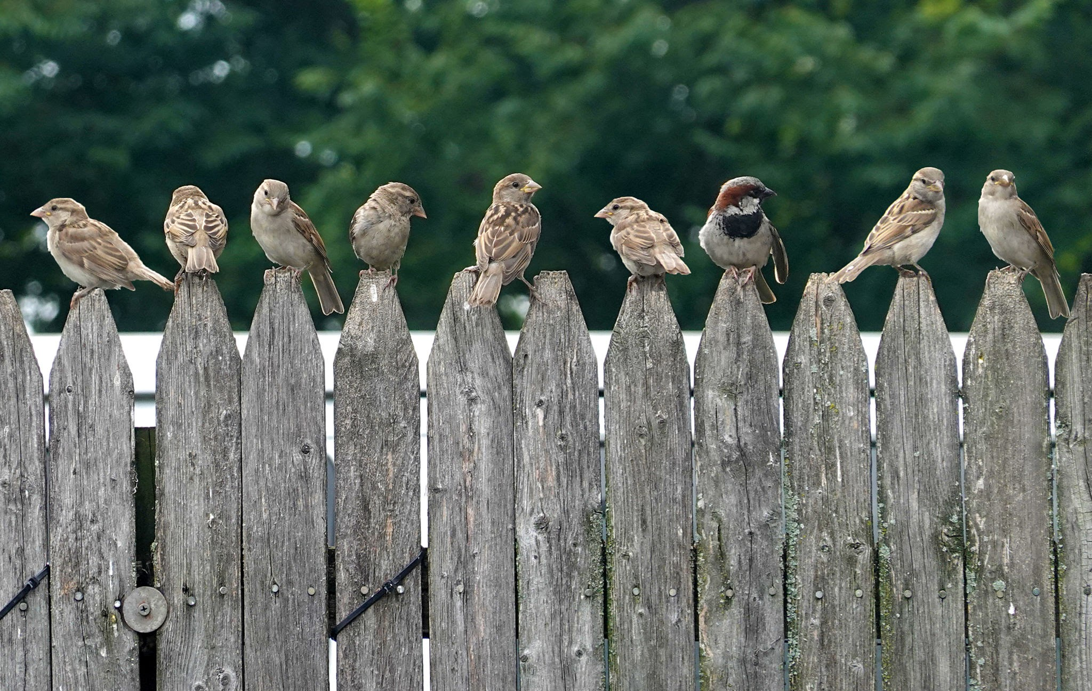
Let’s go forwards (more)

Slide 80
Let’s go forwards (more)

Slide 81
Let’s go forwards (more)

Slide 82
Let’s go forwards (more)

Slide 83
Let’s go forwards (more)

Slide 84
Let’s go backwards (less)

Slide 85
Let’s go backwards (less)

Slide 86
Let’s go backwards (less)

Slide 87
Let’s go backwards (down)

Slide 88
Let’s go backwards (less)

Slide 89
Let’s go backwards (less)

Slide 90
Count back to 0 from here
1

Slide 91
Count back to 0 from here

Slide 92
Count back to 0 from here

Slide 93
Count back to 0 from here

Slide 94
Count back to 0 from here

Slide 95
Count back to 0 from here

Slide 96
Count back to 0 from here

Slide 97
Count back to 0 from here

Slide 98
Count back to 0 from here

Slide 99
Count back to 0 from here

Slide 100
Count back to 0 from here

Slide 101
Count back to 0 from here

Slide 102
Count back to 0 from here

Slide 103
Count back to 0 from here

Slide 104
Count back to 0 from here

Slide 105
Count back to 0 from here

Slide 106
Count back to 0 from here

Slide 107
Count back to 0 from here

Slide 108
Count back to 0 from here

Slide 109
Count back to 0 from here

Slide 110
Count back to 0 from here

Slide 111
Count back to 0 from here

Slide 112
Count back to 0 from here

Slide 113
Count back to 0 from here

Slide 114
Count back to 0 from here

Slide 115
Count back to 0 from here

Slide 116
Count back to 0 from here

Slide 117
Count back to 0 from here

Slide 118
Count back to 0 from here

Slide 119
Count back to 0 from here

Slide 120
Count back to 0 from here

Slide 121
Count back to 0 from here

Slide 122
Count back to 0 from here

Slide 123
Count back to 0 from here

Slide 124
Count back to 0 from here

Slide 125
Count back to 0 from here

Slide 126
Count back to 0 from here

Slide 127
Count back to 0 from here

