Slide 1


Slide 2
There are 6 basketballs

Slide 3
Share them into 2 groups

Slide 4

Share them into 2 groups

Slide 5
Share them into 2 groups

Slide 6
Share them into 2 groups

Slide 7
Share them into 2 groups

Slide 8
Share them into 2 groups

Slide 9
Share them into 2 groups

Slide 10
Share them into 2 groups

Slide 11
2 groups

Slide 12
How many in each group?

Slide 13
How many in each group?

Slide 14
3 in each group

Slide 15
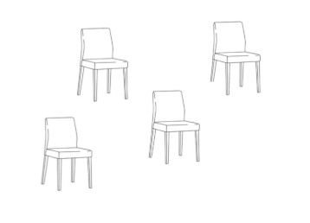
There are 12 chairs

Slide 16
Share them into
3 groups

Slide 17

Share them into
3 groups

Slide 18
Share them into
3 groups

Slide 19
Share them into
3 groups

Slide 20
Share them into
3 groups

Slide 21
Share them into
3 groups

Slide 22
Share them into
3 groups

Slide 23
Share them into
3 groups

Slide 24
Share them into
3 groups

Slide 25
Share them into
3 groups

Slide 26
Share them into
3 groups

Slide 27
Share them into
3 groups

Slide 28
Share them into
3 groups

Slide 29
Share them into
3 groups

Slide 30
How many in
each group?

Slide 31
How many in
each group?

Slide 32
4 in each group

Slide 34
There are 4 basketballs

Slide 35
Share them into 1 group

Slide 36
Share them into 1 group

Slide 37
Share them into 1 group

Slide 38
Share them into 1 group

Slide 39
Share them into 1 group

Slide 40
Share them into 1 group

Slide 41
1 group

Slide 42
How many in each group?

Slide 43
How many in each group?

Slide 44
4 in each group

Slide 46
There are 3 chairs

Slide 47
Share them into
3 groups

Slide 48
Share them into
3 groups

Slide 49
Share them into
3 groups

Slide 50
Share them into
3 groups

Slide 51
Share them into
3 groups

Slide 52
This is
3 groups

Slide 53
How many in
each group?

Slide 54
1 in each group

Slide 55


Slide 56
Share into 3 equal groups

Slide 57
Share into 3 equal groups

Slide 58
Share into 3 equal groups

Slide 59
Share into 3 equal groups

Slide 60
Share into 3 equal groups

Slide 61
Share into 3 equal groups

Slide 62
Share into 3 equal groups

Slide 63
Share into 3 equal groups

Slide 64
Share into 3 equal groups

Slide 65
Share into 3 equal groups

Slide 66
Share into 3 equal groups

Slide 67
Share into 3 equal groups

Slide 68
Share into 3 equal groups

Slide 69
Share into 3 equal groups

Slide 70
This is 3 equal groups

Slide 71
How many in each group?

Slide 72
4 in each group

Slide 73
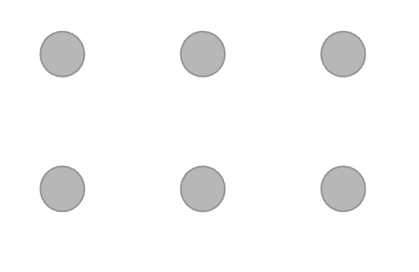

Slide 74
Share into 2 equal groups

Slide 75
Share into 2 equal groups

Slide 76
This is 2 equal groups

Slide 77
How many in each group?

Slide 78
3 in each group

