Slide 1
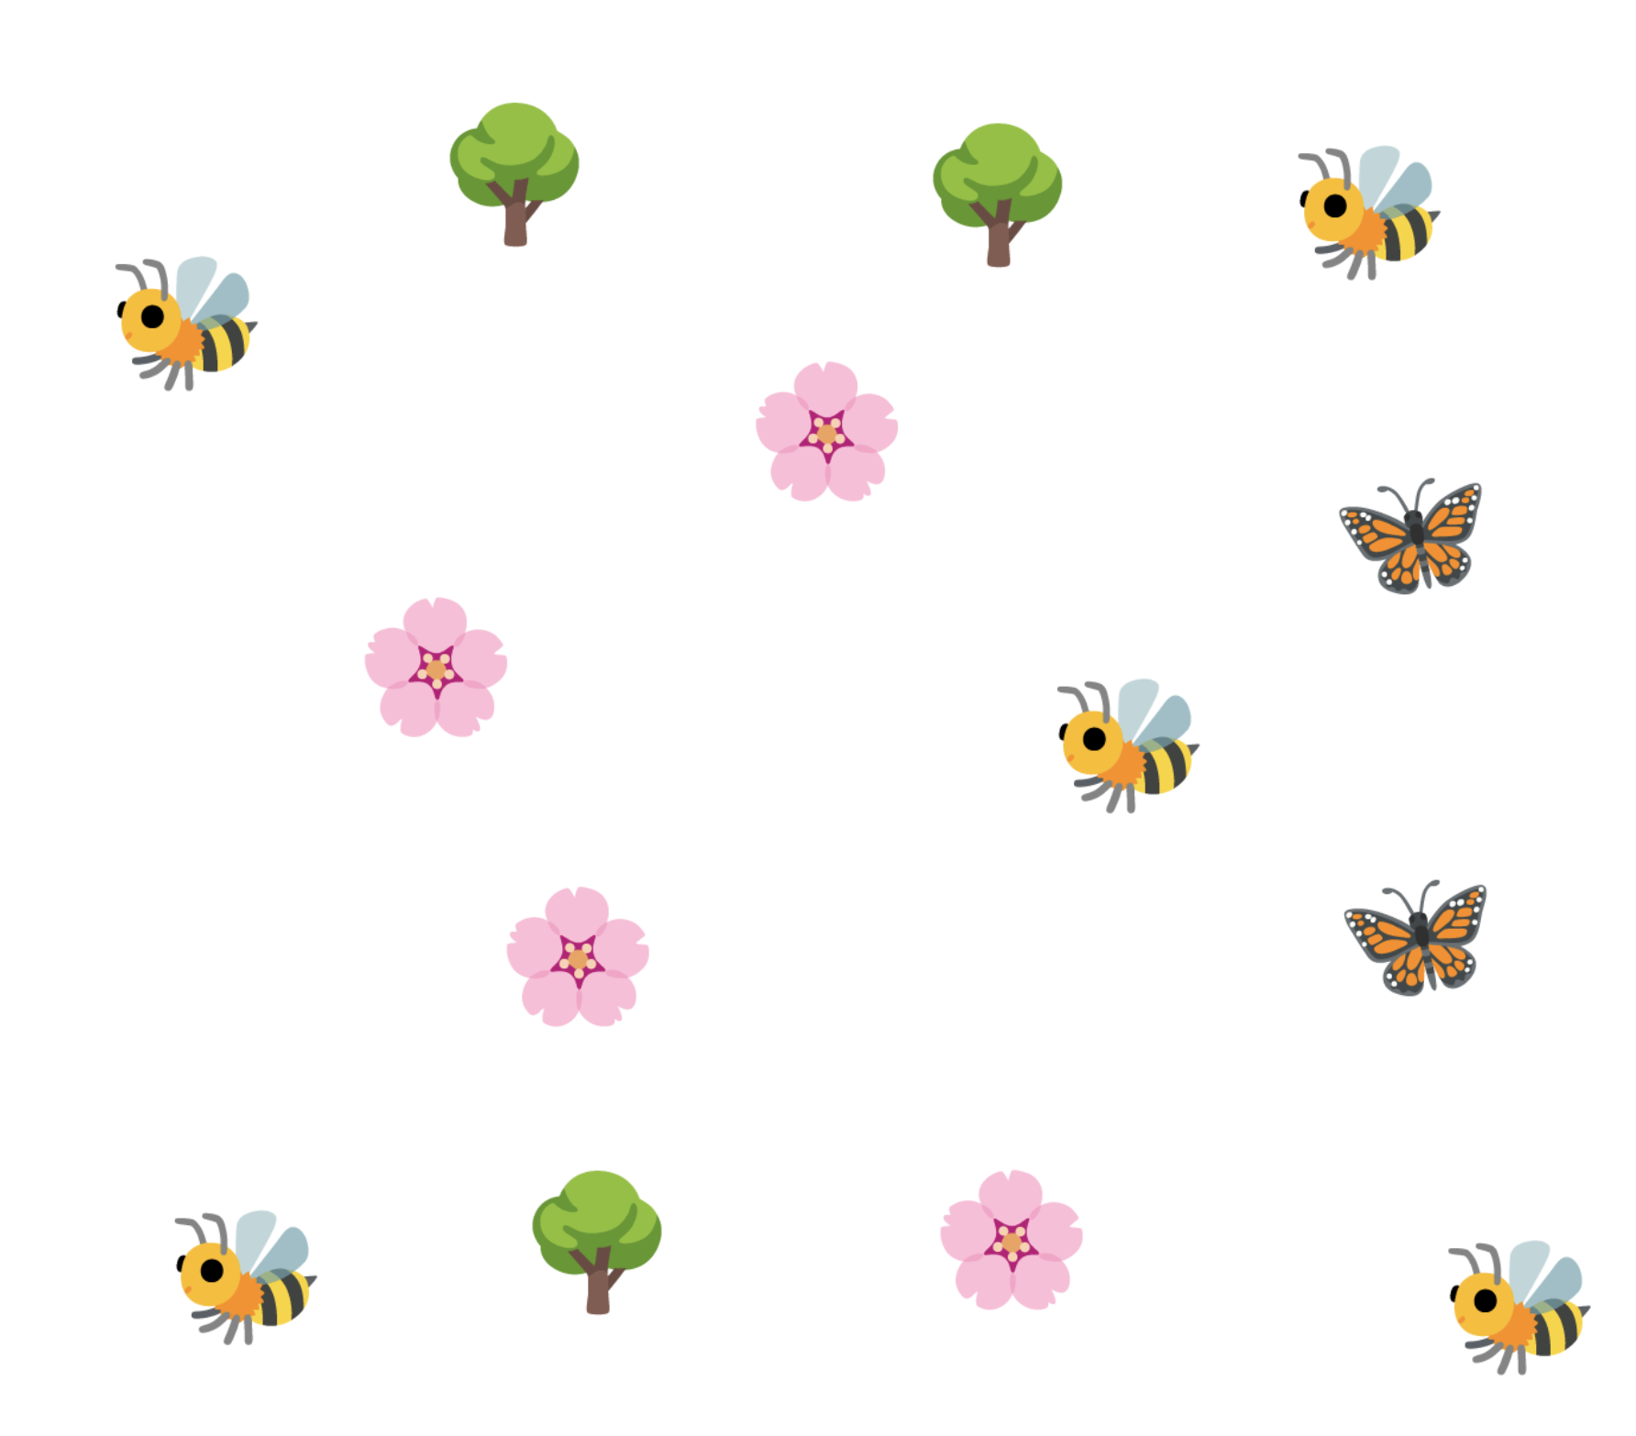
Let’s choose two objects to compare

Slide 2
Bee

Slide 3
Bee and tree

Slide 4
Bee and tree
1

Slide 5
Bee and tree
2
1

Slide 6
Bee and tree
2
1
3

Slide 7
Bee and tree
2
1
3
4

Slide 8
Bee and tree
2
1
3
5
4

Slide 9
Bee and tree
5
2
1
3
5
4

Slide 10
Bee and tree
5
2
1
1
3
5
4

Slide 11
Bee and tree
5
2
1
1
2
3
5
4

Slide 12
Bee and tree
5
2
1
1
2
3
5
3
4

Slide 13
Bee and tree
5
3
2
1
1
2
3
5
3
4

Slide 14
Bee and tree - which has more?
5
3
2
1
1
2
3
5
3
4

Slide 15
There are more bees than trees
5
3
2
1
1
2
3
5
3
4

Slide 16
There are less trees than bees
5
3
2
1
1
2
3
5
3
4

Slide 17
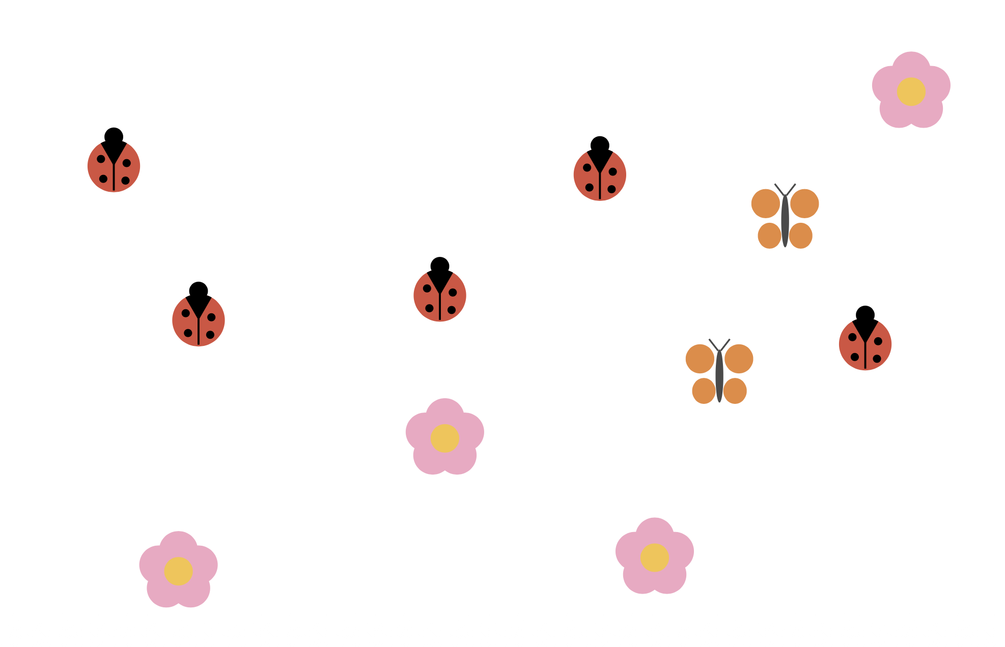
Let’s choose two objects to compare

Slide 18

Let’s choose two objects to compare

Slide 19
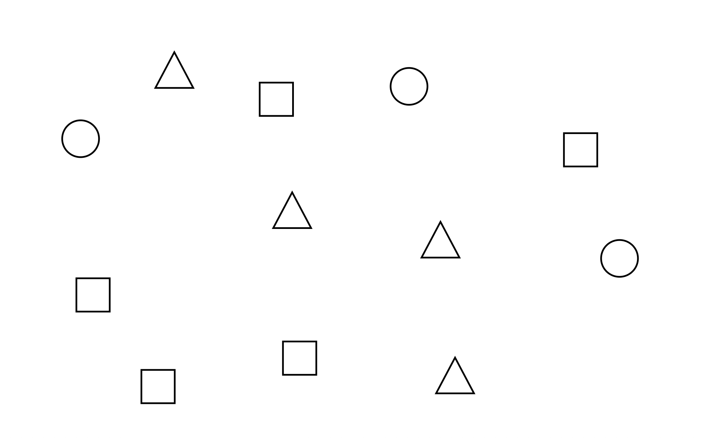
Let’s choose two objects to compare

