Slide 1
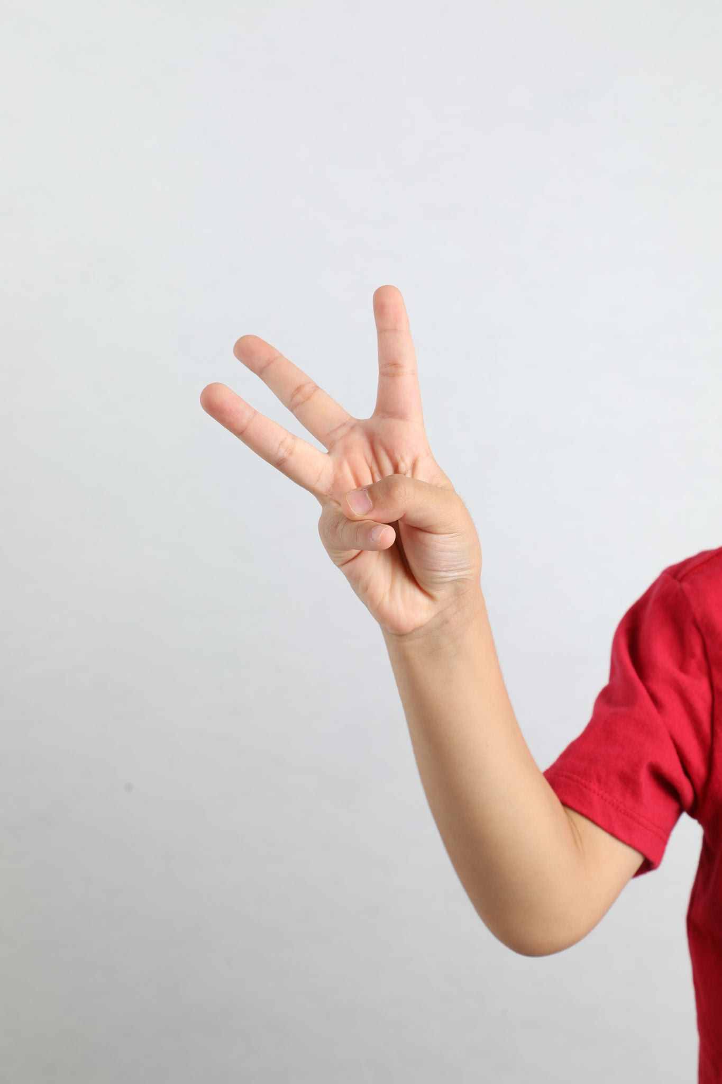
How many fingers am I holding up?

Slide 2
I am holding up 3 fingers

Slide 3
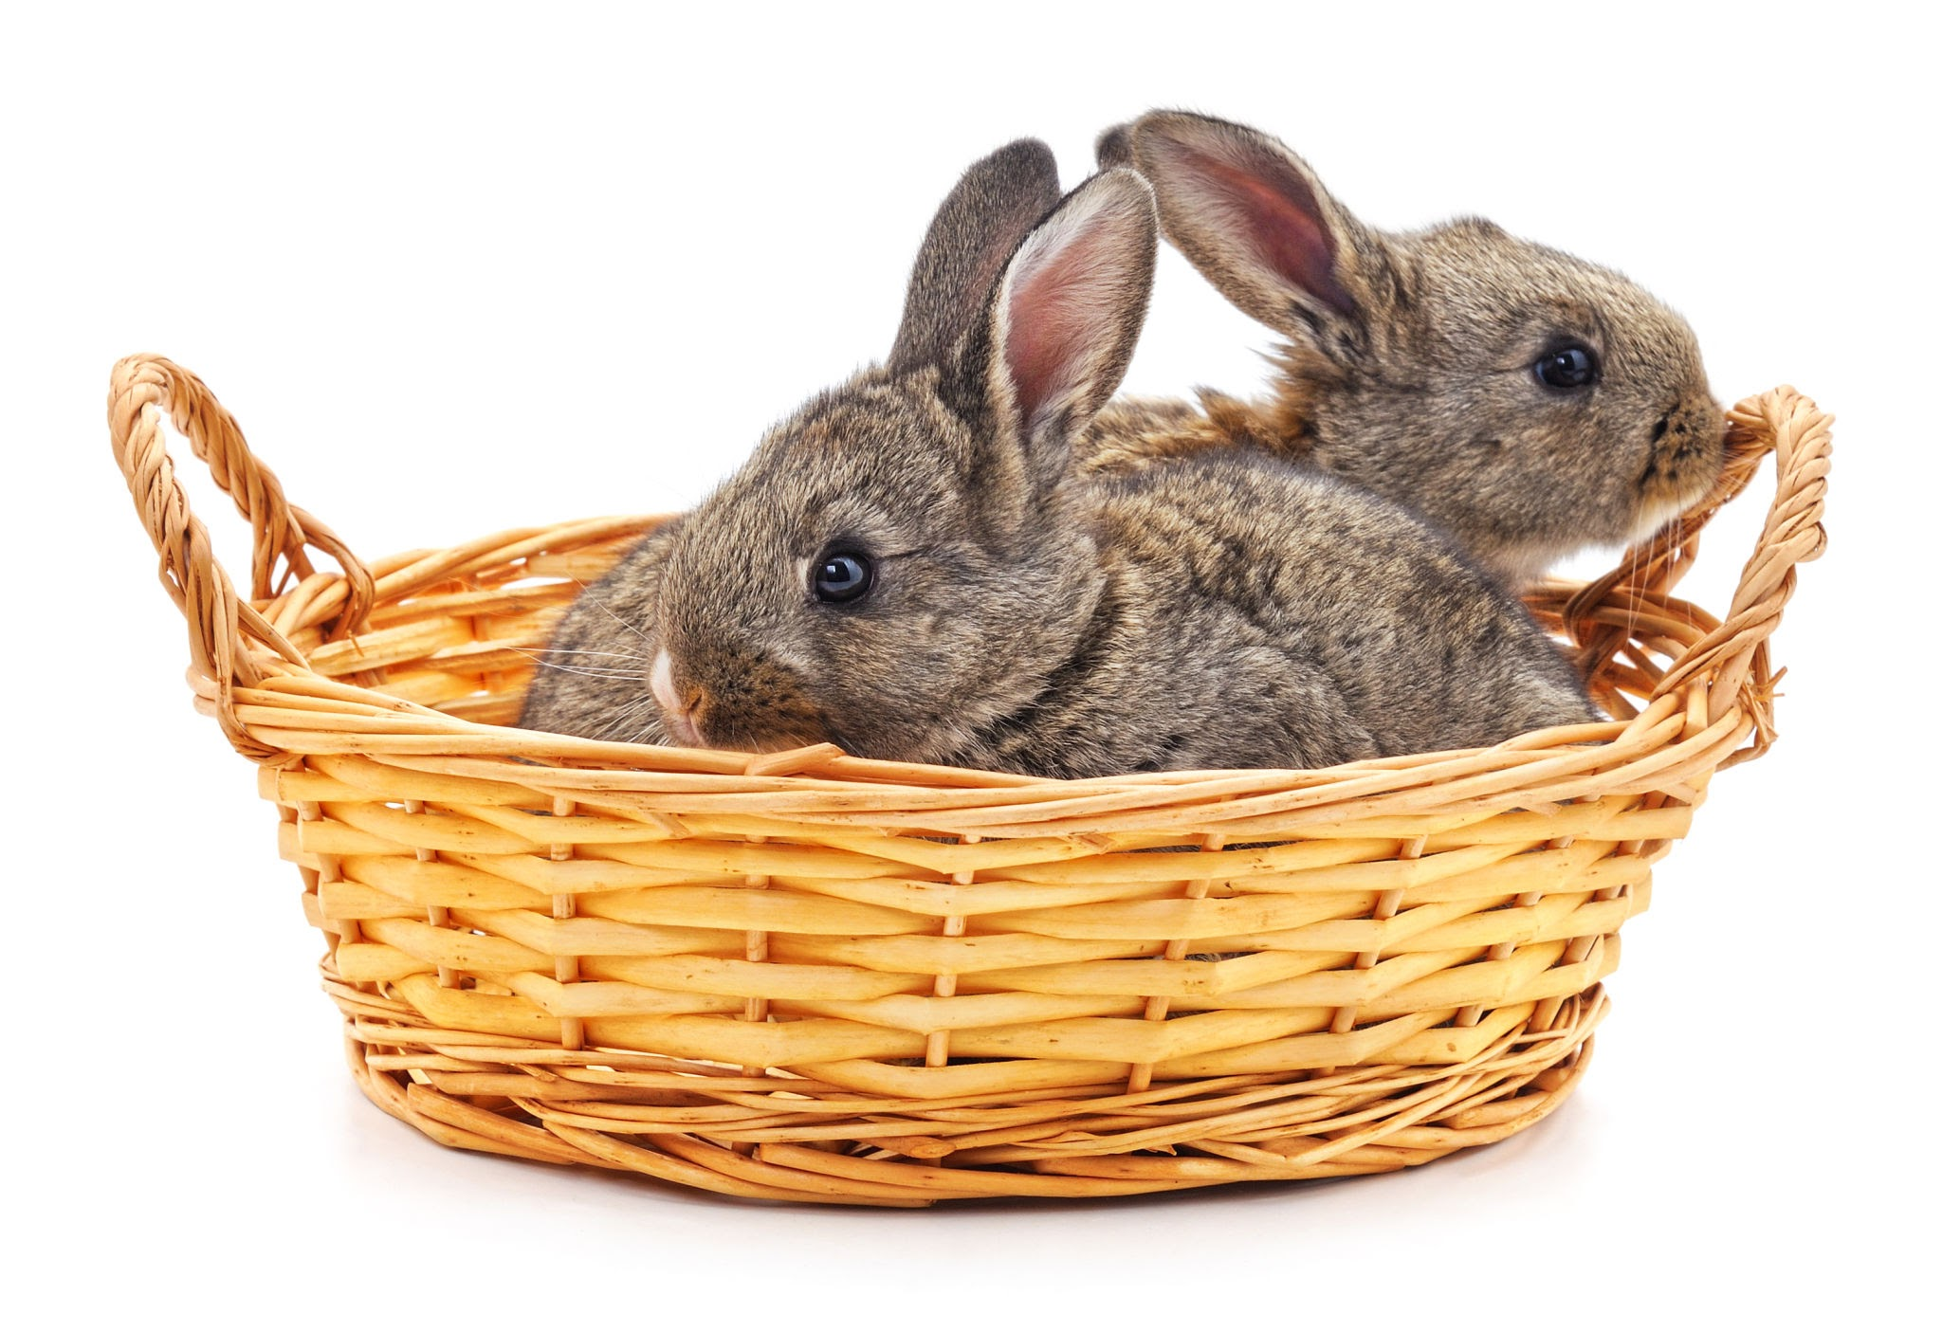
How many rabbits are in the basket?

Slide 4
There are 2 rabbits in the basket

Slide 5
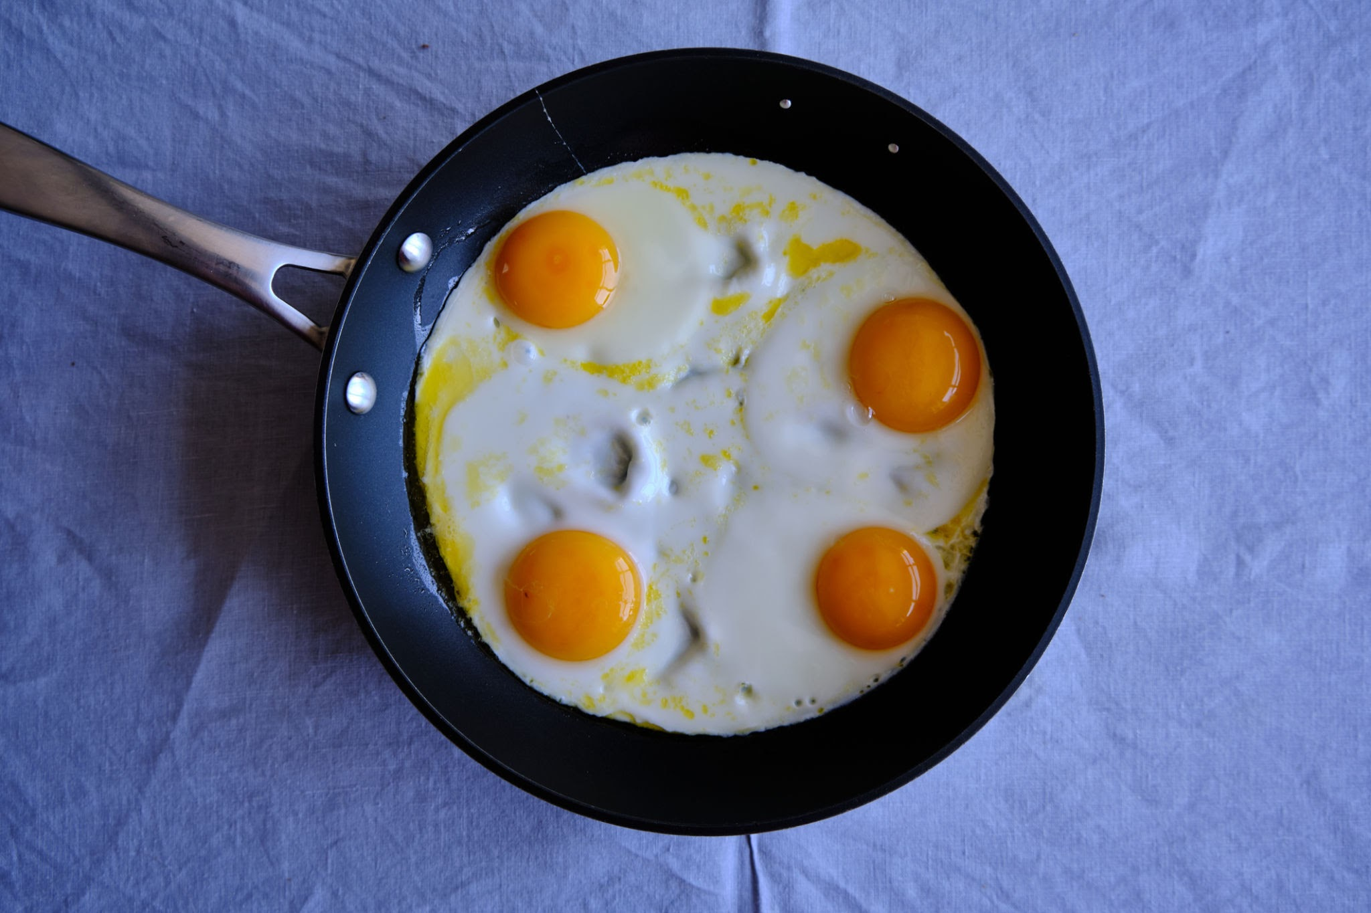
How many eggs are in the pan?

Slide 6
There are 4 eggs are in the pan

Slide 7
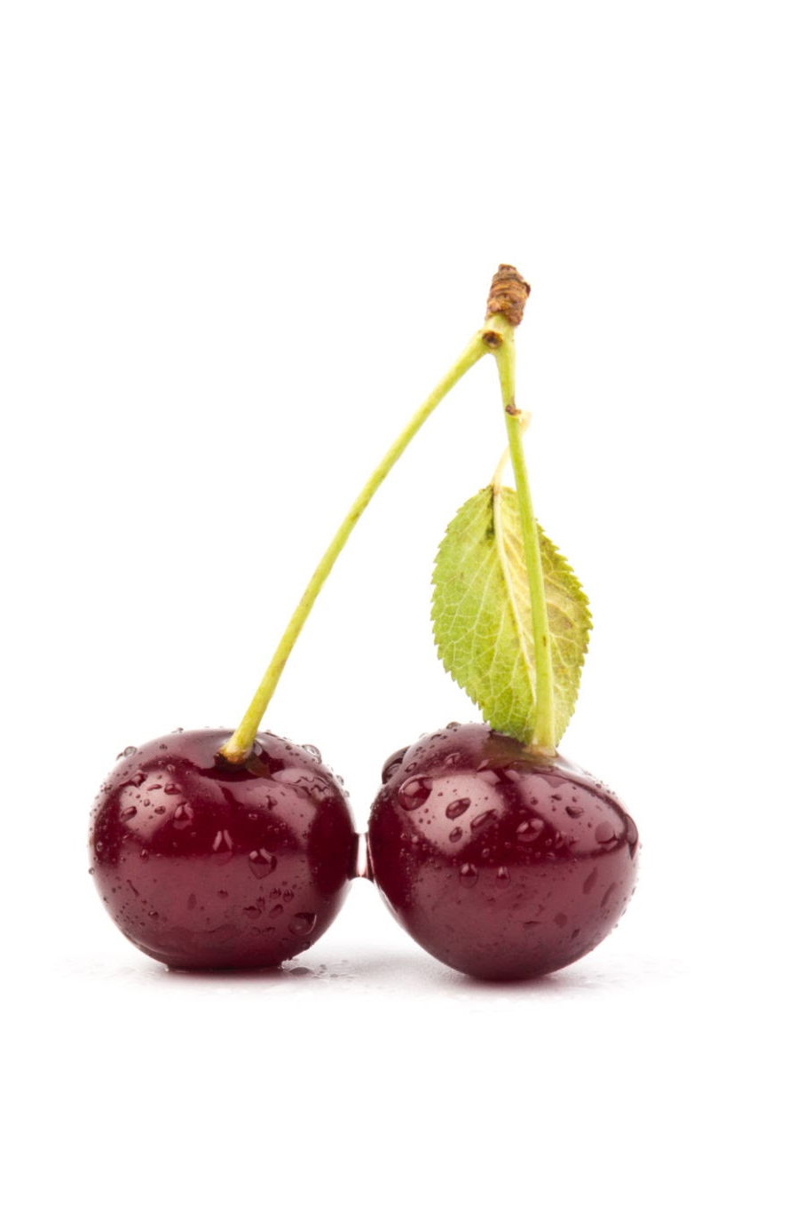
How many cherries are in the bunch?

Slide 8
There are 2 cherries are in the bunch

Slide 9
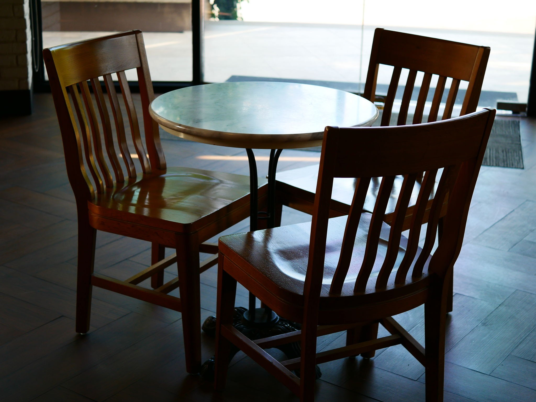
How many chairs are at the table?

Slide 10
There are 3 chairs are at the table

Slide 11

How many people waiting to get in?

Slide 12
There are 5 people waiting to get in

Slide 13
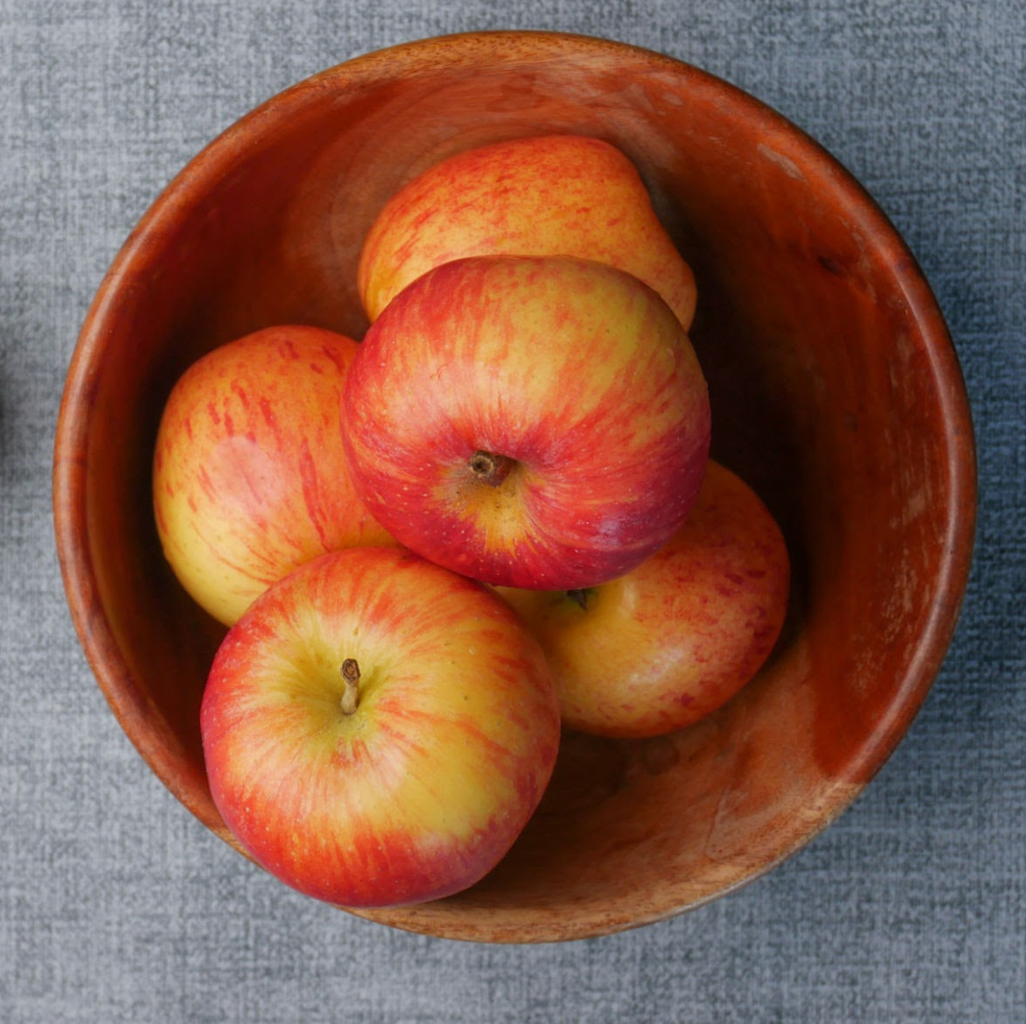
How many apples are in the bowl?

Slide 14
There are 5 apples are in the bowl

Slide 15
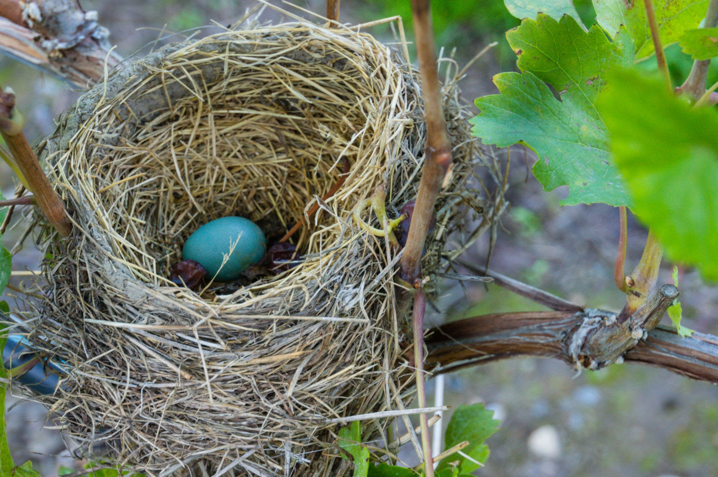
How many eggs are in the nest?

Slide 16
There is 1 egg in the nest

Slide 17
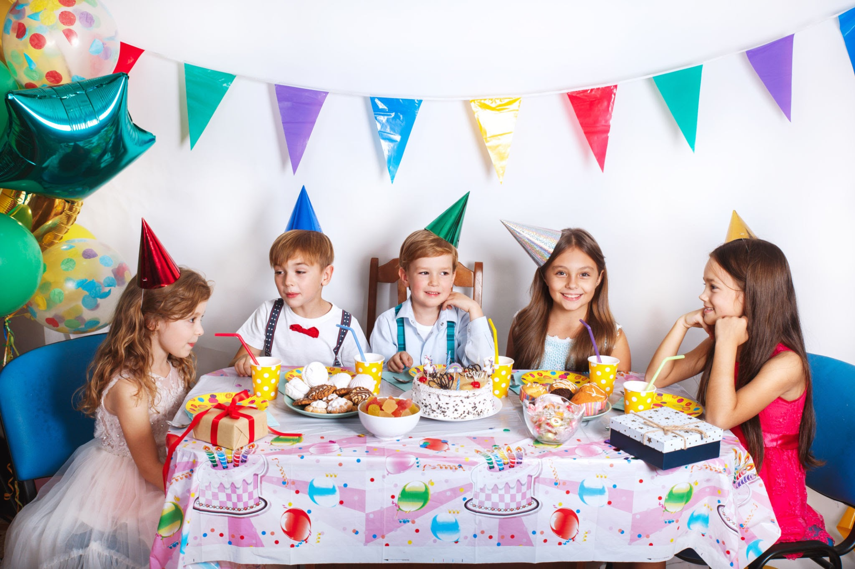
How many children are at this party?

Slide 18
There are 5 children at this party

