Slide 1
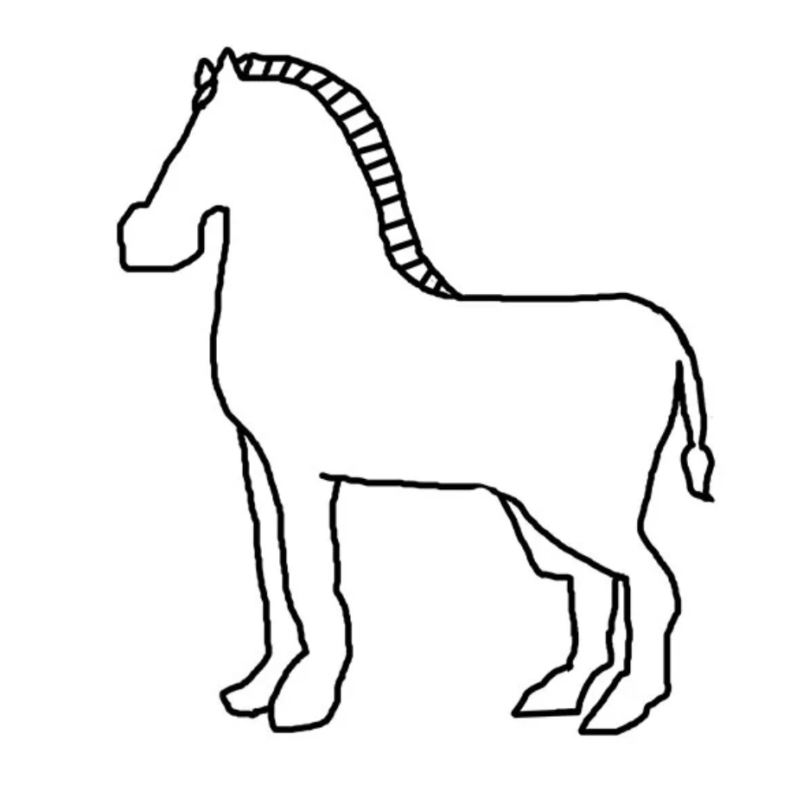
DID YOU KNOW?
Baby zebras are born with…

Slide 2
...spots!

Slide 3
They can have up to 5 spots

Slide 4
Let’s count the spots

Slide 5
1

Slide 6

Group count

Slide 7
Group count

Slide 8
2

Slide 9
Group count

Slide 10
Group count

Slide 11
4

Slide 12
Group count

Slide 13
Group count

Slide 14
5

Slide 15
Group count

Slide 16
Group count

Slide 17
0

Slide 18

Quiet count

Slide 19
Quiet count

Slide 20
2

Slide 21
Quiet count

Slide 22
Quiet count

Slide 23
4

Slide 24
Quiet count

Slide 25
Quiet count

Slide 26
1

Slide 27
Quiet count

Slide 28
Quiet count

Slide 29
3

Slide 30
Quiet count

Slide 31
Quiet count

Slide 32
5

Slide 33
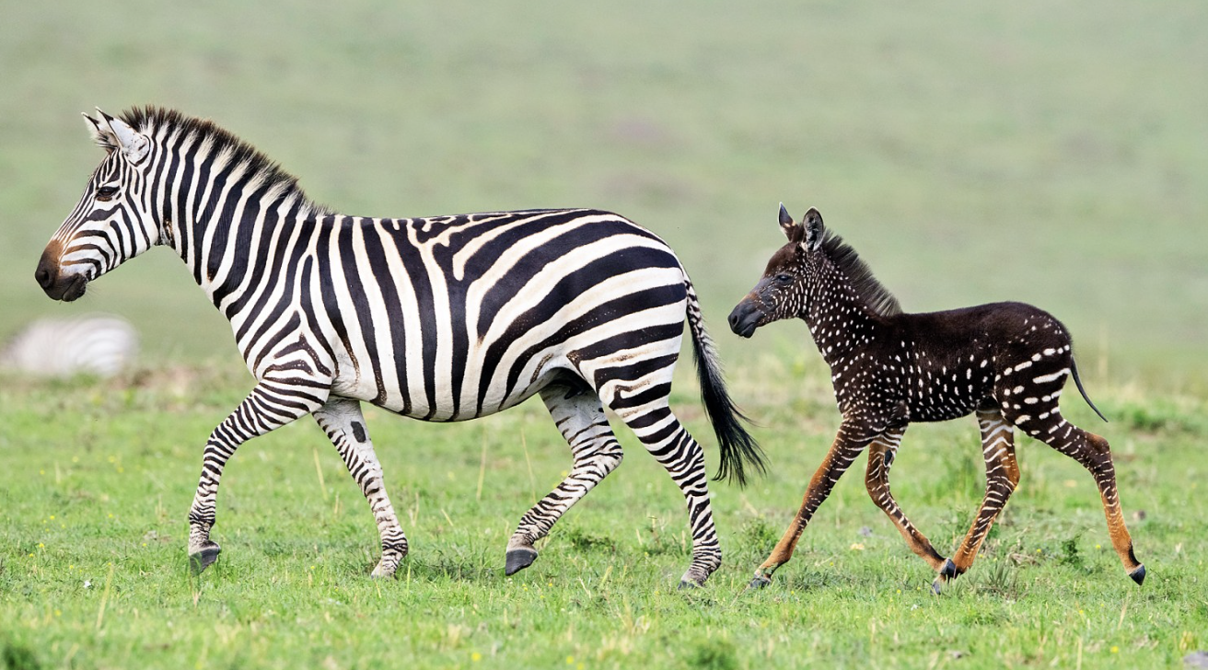
But, baby zebras are very fast

Slide 34
So let’s count the dots quickly!

Slide 65
More practice

