Slide 1
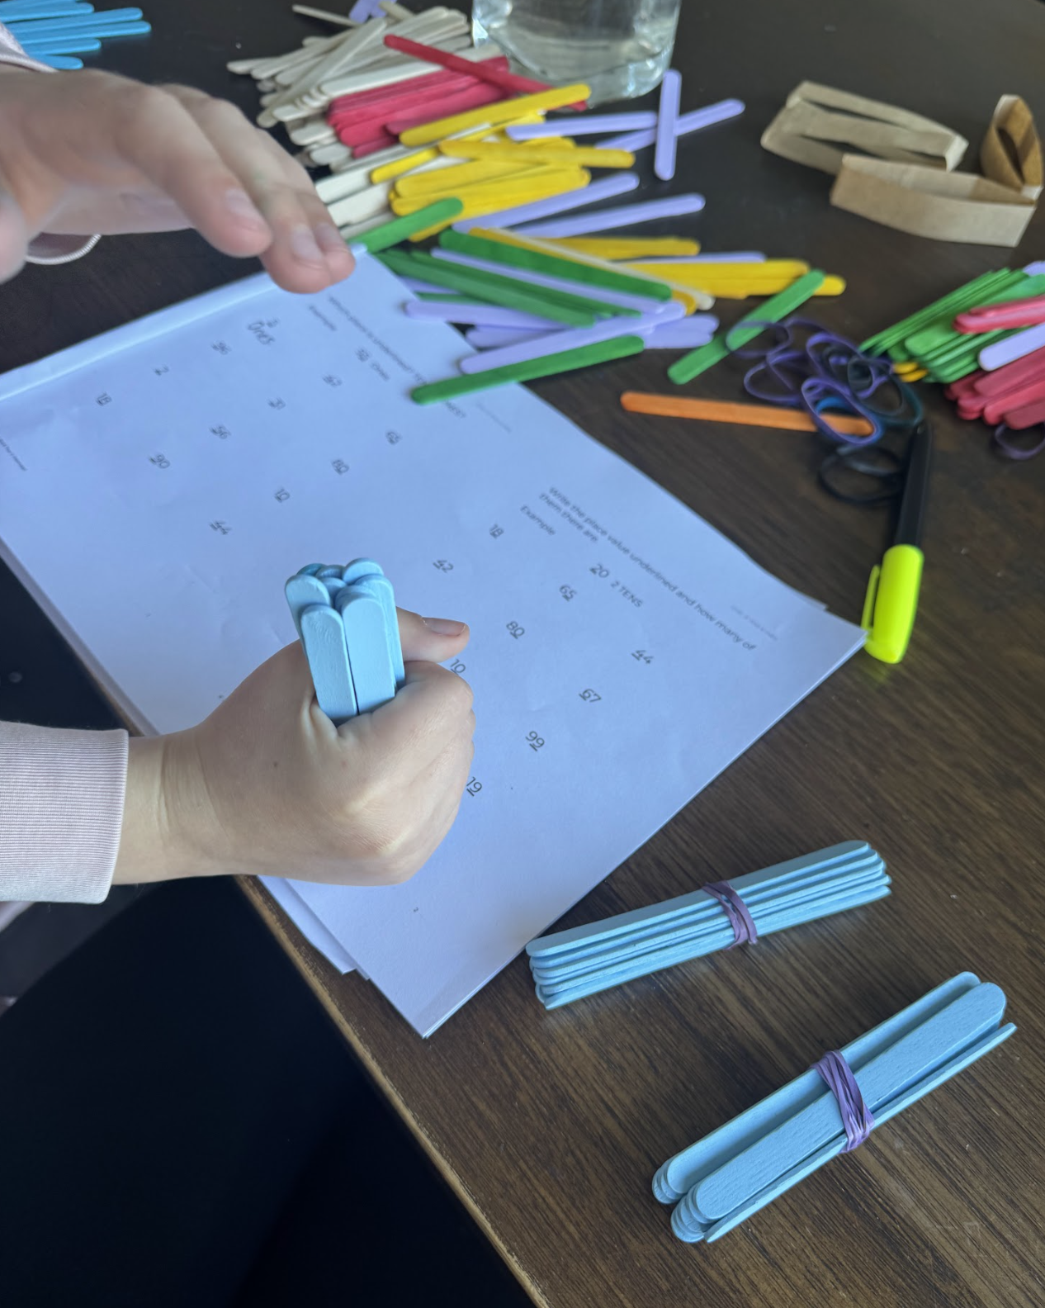
Use your bundles or MAB

Slide 2
45

Slide 3
What is this number?
45

Slide 4
What is this number?
45
Forty-five

Slide 5
How many digits does this number have?
45

Slide 6
How many digits does this number have?
45

Slide 7
How many digits does this number have?
45

Slide 8
The number 45 has 2 digits
45

Slide 9
7

Slide 10
What is this number?
7

Slide 11
What is this number?
7
Seven

Slide 12
How many digits does this number have?
7

Slide 13
How many digits does this number have?
7

Slide 14
The number 7 has 1 digit
7

Slide 15
What is this number?
19

Slide 16
What is this number?
19
Nineteen

Slide 17
How many digits does this number have?
19

Slide 18
How many digits does this number have?
19

Slide 19
How many digits does this number have?
19

Slide 20
The number 19 has 2 digits
19

Slide 21
1

Slide 22
What is this number?
1

Slide 23
What is this number?
1
One

Slide 24
How many digits does this number have?
1

Slide 25
How many digits does this number have?
1

Slide 26
The number 1 has 1 digit
1

Slide 27
Is the underlined digit in the tens or the ones place?
45

Slide 28
45

Slide 29
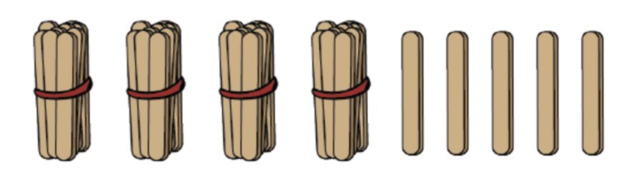
45

Slide 30
Do we make the 4 with tens or ones?
45

Slide 31
Do we make the 4 with tens or ones?
45

Slide 32
45
tens

Slide 33
45

Slide 34
Do we make the 5 with tens or ones?
45

Slide 35
45

Slide 36
45
ones

Slide 37
68

Slide 38
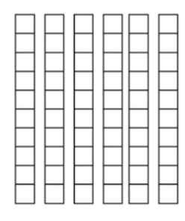

68

Slide 39
68

Slide 40
Do we make the 6 with tens or ones?
68

Slide 41
Do we make the 6 with tens or ones?
68

Slide 42
68
tens

Slide 43
68

Slide 44
68

Slide 45
Do we make the 8 with tens or ones?
68

Slide 46
Do we make the 8 with tens or ones?
68

Slide 47
68
ones

Slide 48
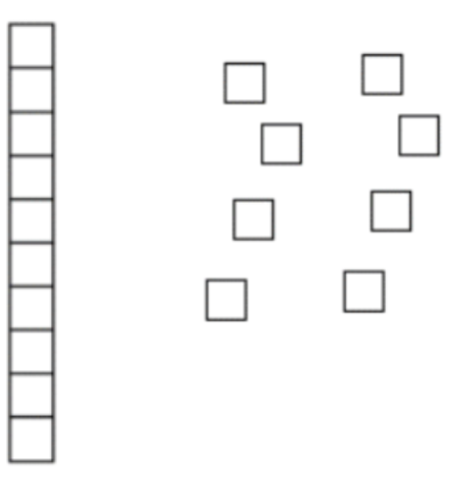
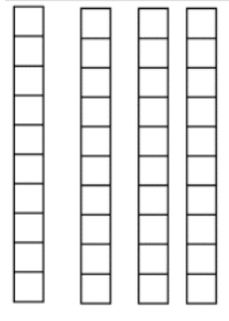
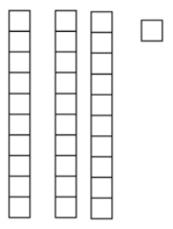
18 40 31

Slide 49
18 40 31

Slide 50
18 40 31
ones

Slide 51
18 40 31
ones

Slide 52
Is the underlined digit in the tens or the ones place?
18 40 31
ones
tens

Slide 53
Is the underlined digit in the tens or the ones place?
18 40 31
ones
tens

Slide 54
Is the underlined digit in the tens or the ones place?
18 40 31
ones
tens
tens

Slide 55
67 79 90

Slide 56
67 79 90

Slide 57
67 79 90
tens

Slide 58
67 79 90
6 tens

Slide 59
67 79 90
6 tens

Slide 60
67 79 90
6 tens

Slide 61
67 79 90
6 tens ones

Slide 62
67 79 90
6 tens 9 ones

Slide 63
67 79 90
6 tens 9 ones

Slide 64
67 79 90
6 tens 9 ones

Slide 65
67 79 90
6 tens 9 ones

Slide 66
67 79 90
6 tens 9 ones tens

Slide 67
67 79 90
6 tens 9 ones 9 tens

