Slide 1
Count

Slide 2
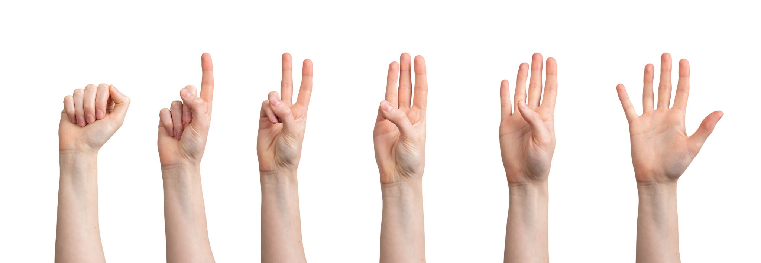

Slide 8
Count

Slide 13
Count

Slide 17
Count

Slide 22
Count without the fingers

Slide 24
Count without the fingers

Slide 26
Count without the fingers

Slide 28
Count without the fingers

