Slide 1
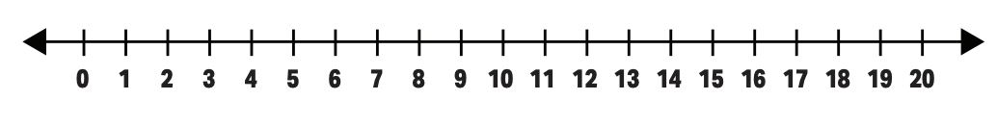
Number line

Slide 2
Number line

Slide 3
Number line
Can you still work out where the values are?

Slide 4
Number line
Where is 5?

Slide 5
Number line
Where is 5?

Slide 6
Number line
Where is 5?

Slide 7
Number line
Where is 5?

Slide 8
Number line
Where is 5?

Slide 9
Number line
Where is 5?

Slide 10
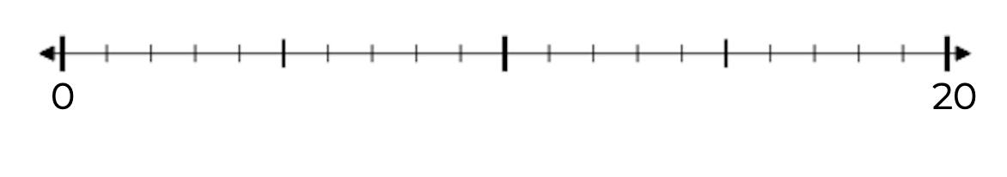
Number line
What are the darker lines on this number line?

Slide 11
Number line
What are the darker lines on this number line?
10

Slide 12
Number line
What are the darker lines on this number line?
5
10

Slide 13
Number line
What are the darker lines on this number line?
5
10
15

Slide 14
Number line
Does it make it easier to find values?

Slide 15
Number line
Where is 11?

Slide 16
Number line
Where is 4?

Slide 17
Number line
Where is 19?

Slide 18
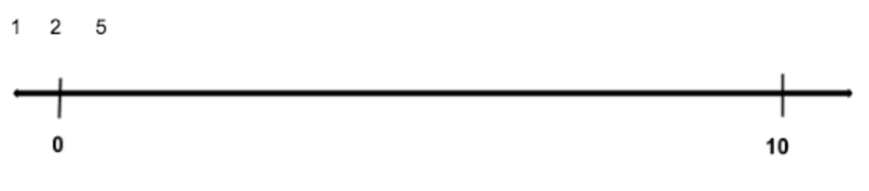
There are no markings

Slide 19
What value is in the middle of 0 and 10?
?

Slide 20
What value is in the middle of 0 and 10?
5

Slide 21
Where is 6?

Slide 22
Where is 6?
Well if 5 is in the middle, which side is 6?
5

Slide 23
Where is 6?
5

Slide 24
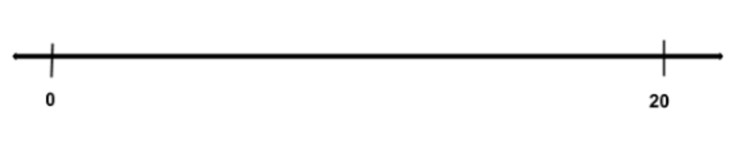
There are no markings

Slide 25
What value is in the middle of 0 and 20?
?

Slide 26
10

Slide 27
What value is in the middle of 0 and 10?
?
10

Slide 28
5
10

Slide 29
What value is in the middle of 10 and 20?
5
10
?

Slide 30
5
10
15

Slide 31
We can use these to help with other numbers
5
10
15

Slide 32
There are no markings

Slide 33
Where is 12?

Slide 34
Where is 12?
5
10
15

Slide 35
About here
5
10
15

Slide 36
There are no markings

Slide 37
Where is 7?

Slide 38
Where is 7?
5
10
15

Slide 39
About here
5
10
15

