Slide 1
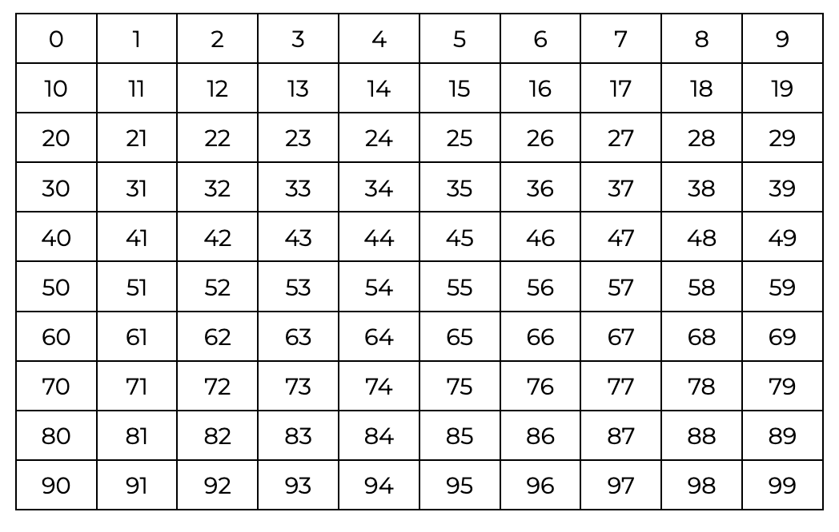
What patterns do you notice?

Slide 2
What patterns do you notice?

Slide 3
What patterns do you notice?

Slide 4

What patterns do you notice?

Slide 5
What patterns do you notice?

Slide 6
What patterns do you notice?

Slide 7
What patterns do you notice?

Slide 8
What patterns do you notice?

Slide 9
What patterns do you notice?

Slide 10
What patterns do you notice?

Slide 11
What patterns do you notice?

Slide 12
What patterns do you notice?

Slide 13
What patterns do you notice?

Slide 14
What patterns do you notice?

Slide 15
What patterns do you notice?

Slide 16
What patterns do you notice?

Slide 17
What patterns do you notice?

Slide 18
Let’s count
17, 18, 19, 20

Slide 19
Let’s count
17, 18, 19, 20, 21

Slide 20
Let’s count
17, 18, 19, 20, 21, 22

Slide 21
Let’s count
17, 18, 19, 20, 21, 22, 23

Slide 22
Let’s count
17, 18, 19, 20, 21, 22, 23, 24

Slide 23
Let’s count
17, 18, 19, 20, 21, 22, 23, 24, 25

Slide 24
Let’s count
17, 18, 19, 20, 21, 22, 23, 24, 25, 26

Slide 25
Let’s count
17, 18, 19, 20, 21, 22, 23, 24, 25, 26, 27

Slide 26
Let’s count
17, 18, 19, 20, 21, 22, 23, 24, 25, 26, 27, 28

Slide 27
Let’s count
17, 18, 19, 20, 21, 22, 23, 24, 25, 26, 27, 28, 29

Slide 28
Let’s count
17, 18, 19, 20, 21, 22, 23, 24, 25, 26, 27, 28, 29, 30

Slide 29
Let’s hear the pattern
20
twenty

Slide 30
Let’s hear the pattern
21
twenty-one

Slide 31
Let’s hear the pattern
22
twenty-two

Slide 32
Let’s hear the pattern
23
twenty-three

Slide 33
Let’s hear the pattern
24
twenty-four

Slide 34
Let’s hear the pattern
25
twenty-five

Slide 35
Let’s hear the pattern
26
twenty-six

Slide 36
Let’s hear the pattern
27
twenty-seven

Slide 37
Let’s hear the pattern
28
twenty-eight

Slide 38
Let’s hear the pattern
29
twenty-nine

Slide 39
Let’s hear the pattern
30
thirty

