Slide 1
40 + 20 =

Slide 2
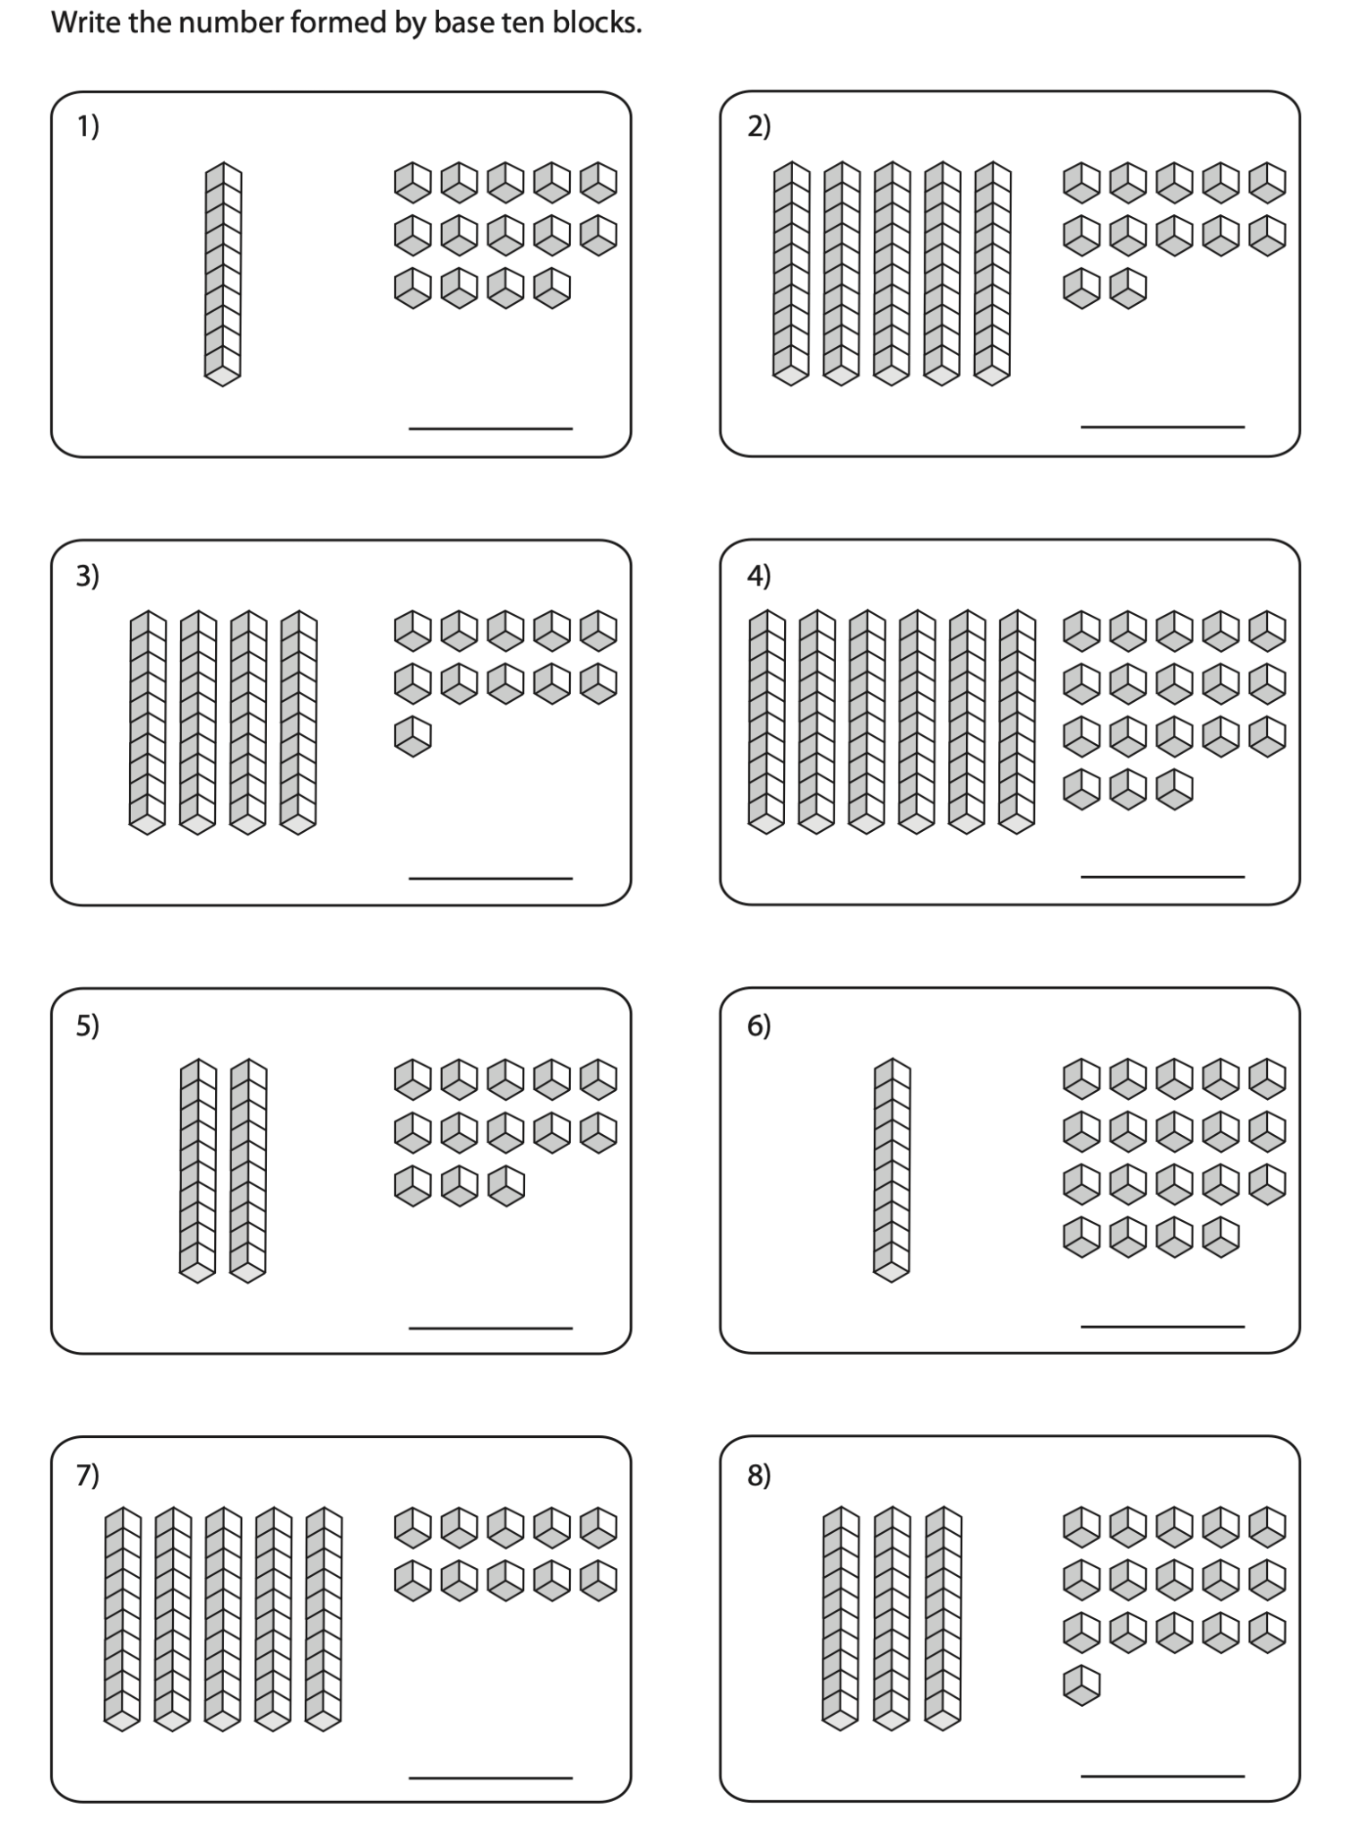
40 + 20 =

Slide 3
40 + 20 =

Slide 4
40 + 20 = 60

Slide 5
10 + 60 =

Slide 6
10 + 60 =

Slide 7
10 + 60 =

Slide 8
10 + 60 = 70

Slide 9
30 + 40 =

Slide 10
30 + 40 =

Slide 11
30 + 40 =

Slide 12
30 + 40 = 70

Slide 13
60 - 10 =

Slide 14
60 - 10 =

Slide 15
60 - 10 =

Slide 16
60 - 10 = 50

Slide 17
80 - 50 =

Slide 18
80 - 50 =

Slide 19
80 - 50 =

Slide 20
80 - 50 = 30

Slide 21
40 + 27 =

Slide 22
40 + 27 =

Slide 23
40 + 27 =

Slide 24
40 + 27 = 67

Slide 25
10 + 65 =

Slide 26
10 + 65 =

Slide 27
10 + 65 =

Slide 28
10 + 65 = 75

Slide 29
63 - 20 =

Slide 30
63 - 20 =

Slide 31
63 - 20 =

Slide 32
63 - 20 = 43

Slide 33
81 - 10 =

Slide 34
81 - 10 =

Slide 35
81 - 10 =

Slide 36
81 - 10 = 71

