Slide 1
Let’s count on

Slide 2
Let’s count on
7 + 2
or 2 + 7

Slide 3
Let’s count on
7 + 2
or 2 + 7
7,

Slide 4
Let’s count on
7 + 2
or 2 + 7
7, 8,

Slide 5
Let’s count on
7 + 2
or 2 + 7
7, 8, 9

Slide 6
Let’s count on
7 + 2
or 2 + 7
7, 8 , 9

Slide 7
Let’s count on
7 + 2
or 2 + 7
7, 8 , 9
2,

Slide 8
Let’s count on
7 + 2
or 2 + 7
7, 8 , 9
2, 3,

Slide 9
Let’s count on
7 + 2
or 2 + 7
7, 8 , 9
2, 3, 4,

Slide 10
Let’s count on
7 + 2
or 2 + 7
7, 8 , 9
2, 3, 4, 5,

Slide 11
Let’s count on
7 + 2
or 2 + 7
7, 8 , 9
2, 3, 4, 5, 6,

Slide 12
Let’s count on
7 + 2
or 2 + 7
7, 8 , 9
2, 3, 4, 5, 6, 7,

Slide 13
Let’s count on
7 + 2
or 2 + 7
7, 8 , 9
2, 3, 4, 5, 6, 7, 8,

Slide 14
Let’s count on
7 + 2
or 2 + 7
7, 8 , 9
2, 3, 4, 5, 6, 7, 8, 9

Slide 15
Let’s count on
7 + 2
or 2 + 7
7, 8 , 9
2, 3, 4, 5, 6, 7, 8, 9
0
1
2
3
4
5
6
7
8
9
10
11
12
13
14

Slide 16
Let’s count on
7 + 2
or 2 + 7
7, 8 , 9
2, 3, 4, 5, 6, 7, 8, 9
0
1
2
3
4
5
6
7
8
9
10
11
12
13
14

Slide 17
Let’s count on
7 + 2
or 2 + 7
7, 8 , 9
2, 3, 4, 5, 6, 7, 8, 9
0
1
2
3
4
5
6
7
8
9
10
11
12
13
14

Slide 18
Let’s count on
7 + 2
or 2 + 7
7, 8 , 9
2, 3, 4, 5, 6, 7, 8, 9
0
1
2
3
4
5
6
7
8
9
10
11
12
13
14

Slide 19
Let’s count on
7 + 2
or 2 + 7
7, 8 , 9
2, 3, 4, 5, 6, 7, 8, 9
0
1
2
3
4
5
6
7
8
9
10
11
12
13
14

Slide 20
Let’s count on

Slide 21
Let’s count on
2 + 8
or 8 + 2

Slide 22
Let’s count on
2 + 8
or 8 + 2
2, 3, 4, 5, 6, 7, 8, 9, 10
8, 9, 10

Slide 23
Which one is easier?
2 + 8
or 8 + 2
2, 3, 4, 5, 6, 7, 8, 9, 10
8, 9, 10

Slide 24
Which one is easier?
2 + 8
or 8 + 2
2, 3, 4, 5, 6, 7, 8, 9, 10
8, 9, 10
0
1
2
3
4
5
6
7
8
9
10
11
12
13
14

Slide 25
Which one is easier?
2 + 8
or 8 + 2
2, 3, 4, 5, 6, 7, 8, 9, 10
8, 9, 10
0
1
2
3
4
5
6
7
8
9
10
11
12
13
14

Slide 26
Which one is easier?
2 + 8
or 8 + 2
2, 3, 4, 5, 6, 7, 8, 9, 10
8, 9, 10
0
1
2
3
4
5
6
7
8
9
10
11
12
13
14

Slide 27
Which one is easier?
2 + 8
or 8 + 2
2, 3, 4, 5, 6, 7, 8, 9, 10
8, 9, 10
0
1
2
3
4
5
6
7
8
9
10
11
12
13
14

Slide 28
Which one is easier?
2 + 8
or 8 + 2
2, 3, 4, 5, 6, 7, 8, 9, 10
8, 9, 10
0
1
2
3
4
5
6
7
8
9
10
11
12
13
14

Slide 29
Which one is easier?
5 + 2
or 2 + 5

Slide 30
Which one is easier?
5 + 2
or 2 + 5

Slide 31
Which one is easier?
3 + 6
or 6 + 3

Slide 32
Which one is easier?
3 + 6
or 6 + 3

Slide 33
Which one is easier?
12 + 1
or 1 + 12

Slide 34
Which one is easier?
12 + 1
or 1 + 12

Slide 35
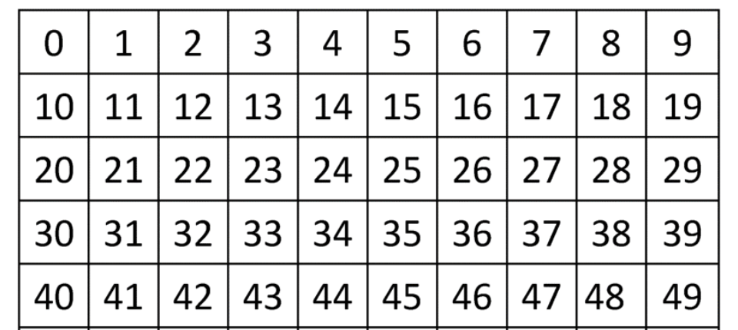
Let’s count on
7 + 2 or 2 + 7

Slide 36
Let’s count on
7 + 2 or 2 + 7

Slide 37
Let’s count on
7 + 2

Slide 38
Let’s count on
7 + 2

Slide 39
Let’s count on
7 + 2

Slide 40
Let’s count on
7 + 2

Slide 41
Let’s count on
7 + 2 = 9

Slide 42
Let’s count on
1 + 15 or 15 + 1

Slide 43
Let’s count on
1 + 15 or 15 + 1

Slide 44
Let’s count on
15 + 1

Slide 45
Let’s count on
15 + 1

Slide 46
Let’s count on
15 + 1

Slide 47
Let’s count on
15 + 1 = 16

Slide 48
Let’s count on
22 + 3

Slide 49
Let’s count on
22 + 3

Slide 50
Let’s count on
22 + 3

Slide 51
Let’s count on
22 + 3

Slide 52
Let’s count on
22 + 3

Slide 53
Let’s count on
22 + 3 = 25

Slide 54
Let’s count on
2 + 17

Slide 55
Let’s count on
2 + 17

Slide 56
Let’s count on
2 + 17

Slide 57
Let’s count on
2 + 17

Slide 58
Let’s count on
20 + 1

Slide 59
Let’s count on
20 + 1

Slide 60
Let’s count on
20 + 1

Slide 61
Let’s count on
20 + 1 = 21

