Slide 1
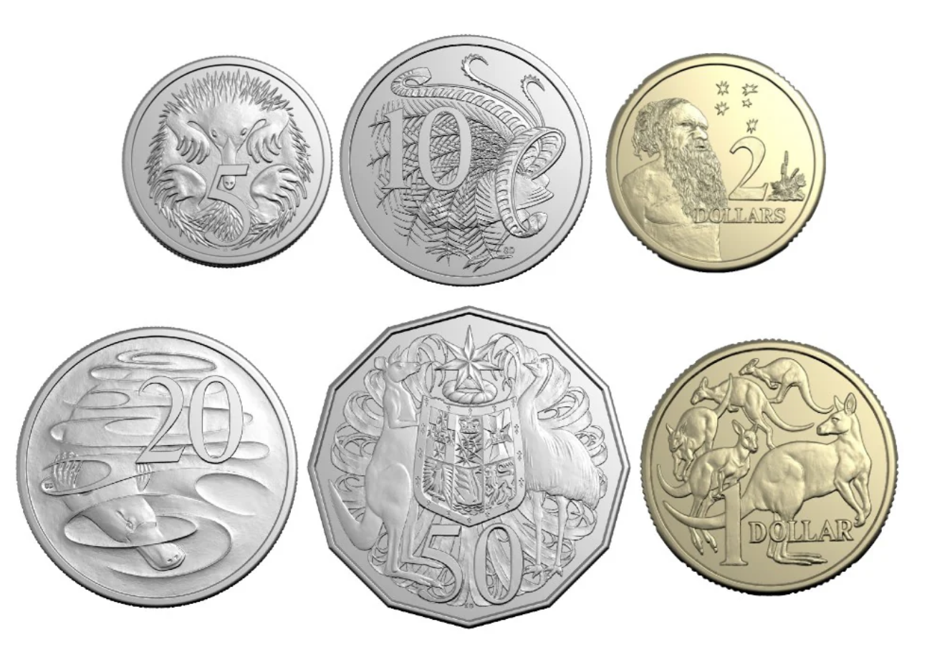
How much is this?

Slide 2
How much is this?
10 cents

Slide 3
What coins can I use to make 10 cents?
10 cents

Slide 4
What coins can I use to make 10 cents?
10 cents

Slide 5
What coins can I use to make 10 cents?
10 cents
5 cents + 5 cents

Slide 6
What coins can I use to make 10 cents?
10 cents
10 cents

Slide 7
How much is this?

Slide 8
How much is this?
20 cents

Slide 9
What coins can I use to make 20 cents?
20 cents

Slide 10
What coins can I use to make 20 cents?
20 cents

Slide 11
What coins can I use to make 10 cents?
20 cents
10 cents + 10 cents

Slide 12
What coins can I use to make 10 cents?
20 cents
20 cents

Slide 13
How much is this?

Slide 14
How much is this?
50 cents

Slide 15
What coins can I use to make 50 cents?
50 cents

Slide 16
What coins can I use to make 50 cents?
50 cents

Slide 17
What coins can I use to make 50 cents?
10 cents + 10 cents + 10 cents + 10 cents + 10 cents
50 cents

Slide 18
What coins can I use to make 50 cents?
50 cents
50 cents

Slide 19
What coins can I use to make 50 cents?
50 cents

Slide 20
What coins can I use to make 50 cents?
50 cents
20 cents + 20 cents + 10 cents

Slide 21
What coins can I use to make 50 cents?
50 cents
50 cents

